Slide 1
Extreme Scale Earthquake Simulation with Crossing Multi-faults and Topography
Lin Gan
Department of Computer Science, Tsinghua University, China
2024-09-10 @ PPAM 2024, Ostrava, Czech Republic

Slide 2
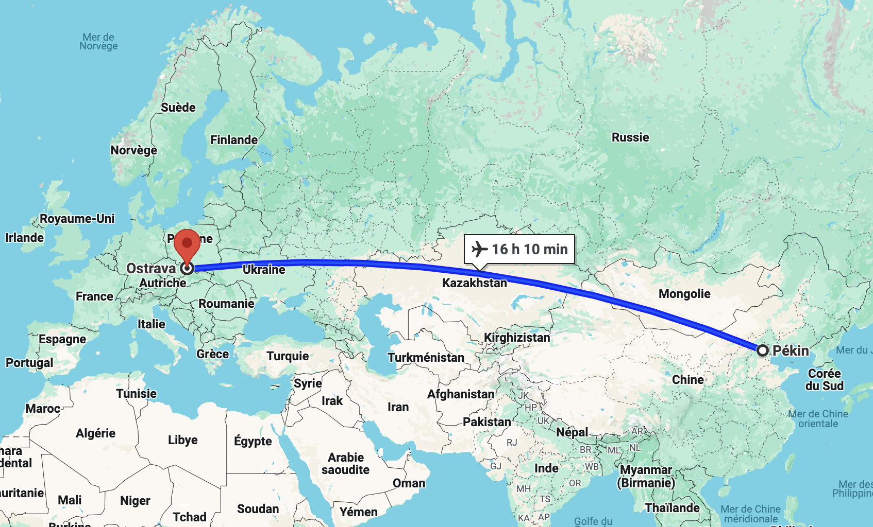
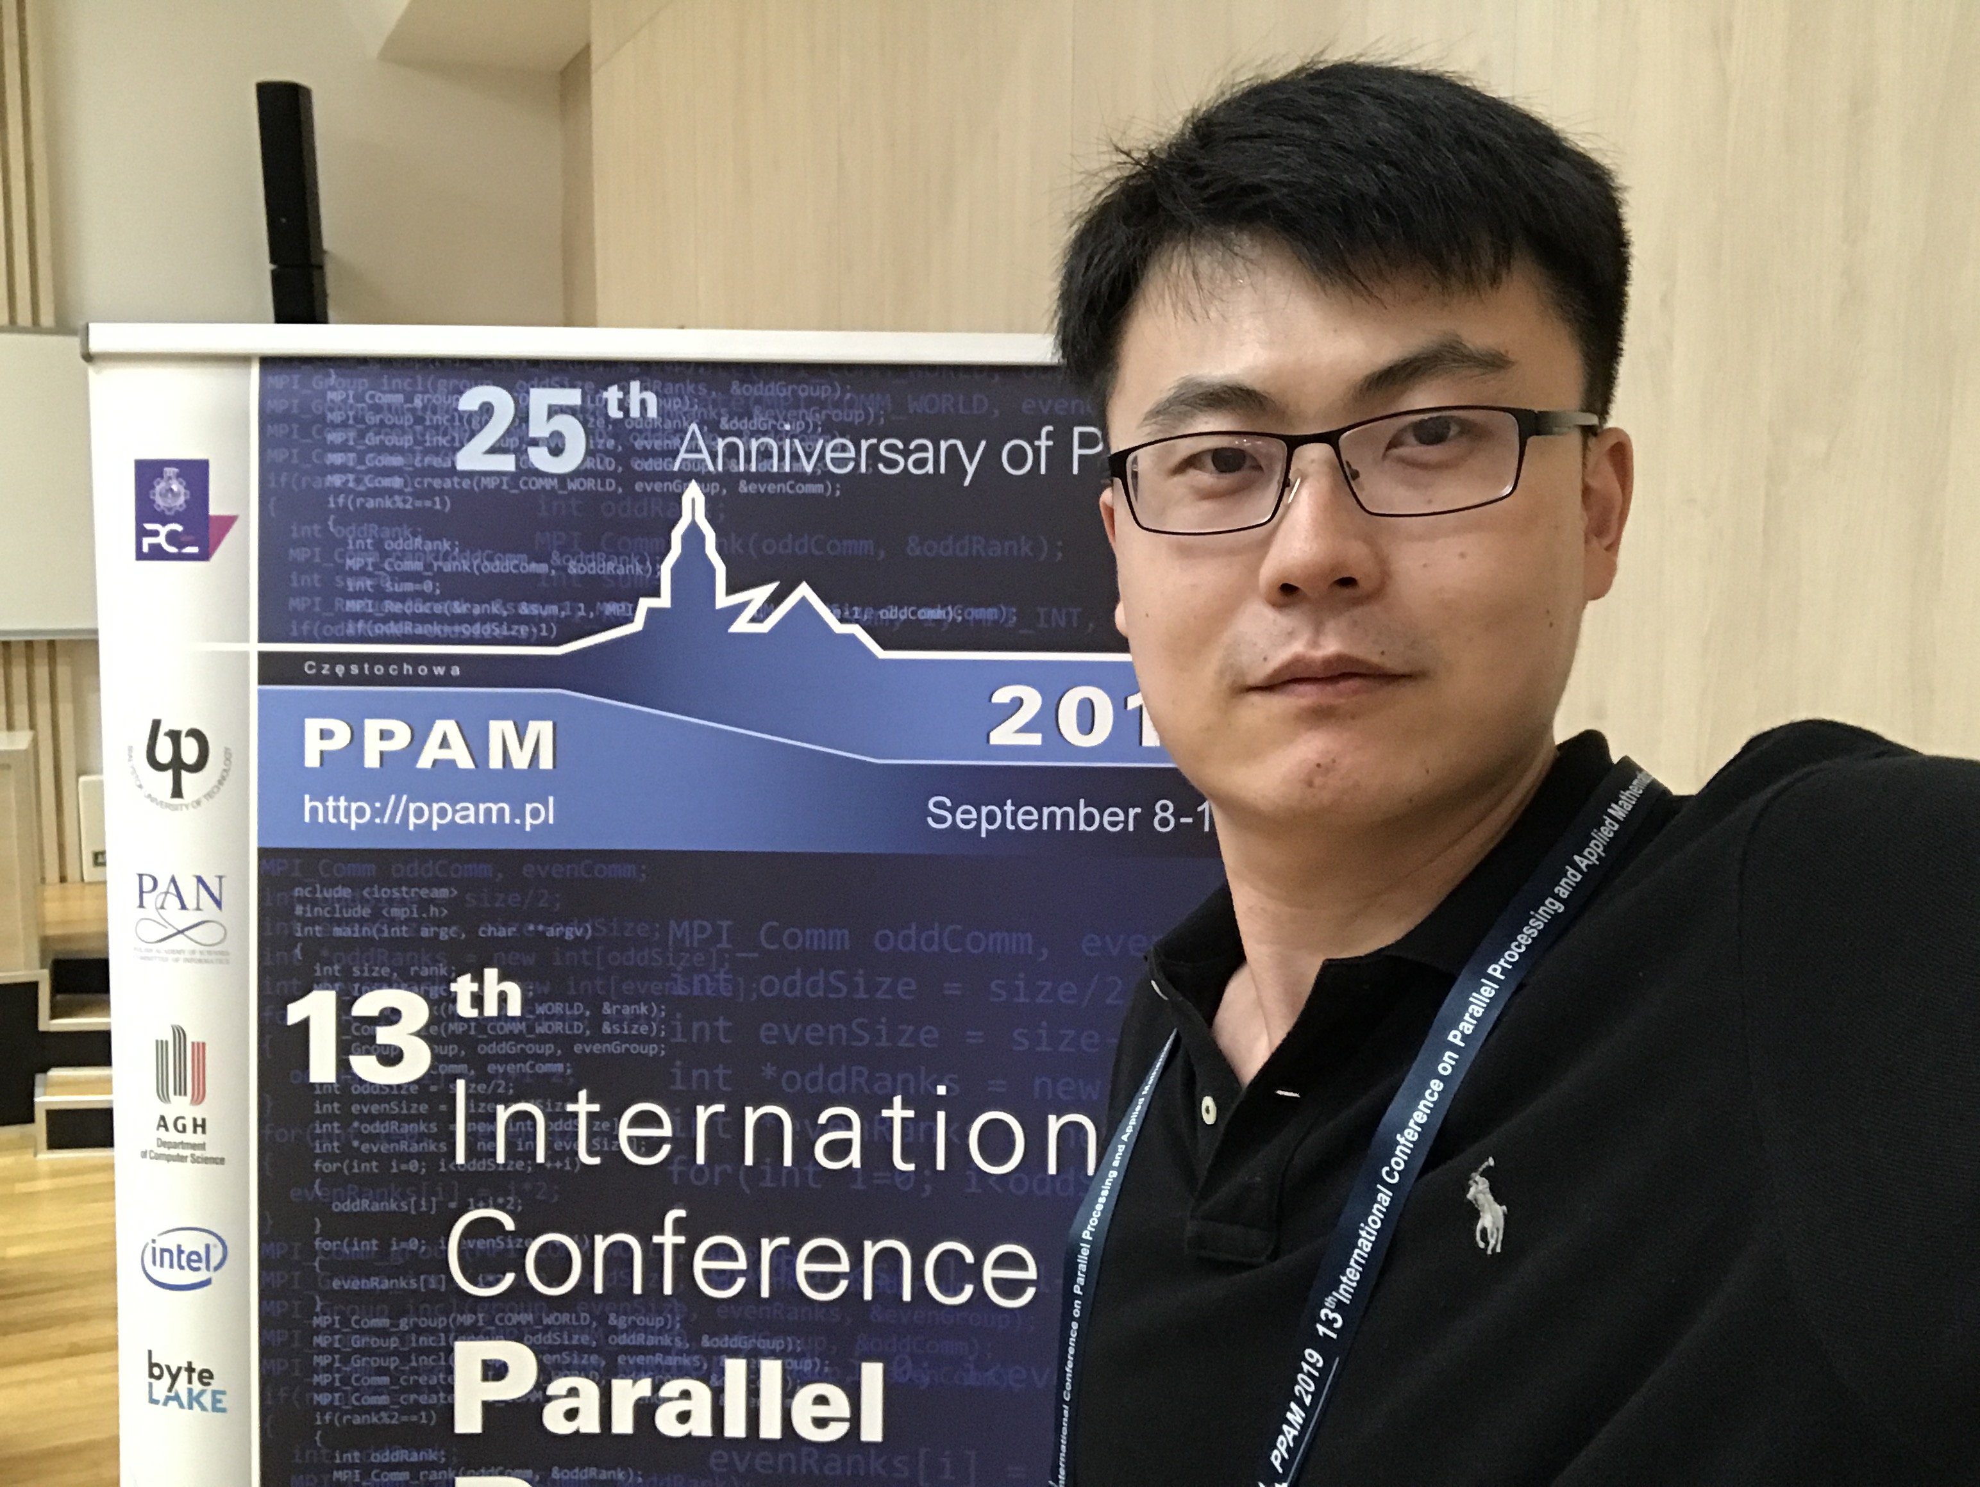
PPAM 2019

Slide 3

Yuanmingyuan Park
Tsinghua University
Since 1911
Top 1 in Engineering & CS in China
Summer
Palace
Zhongguancun

Slide 4
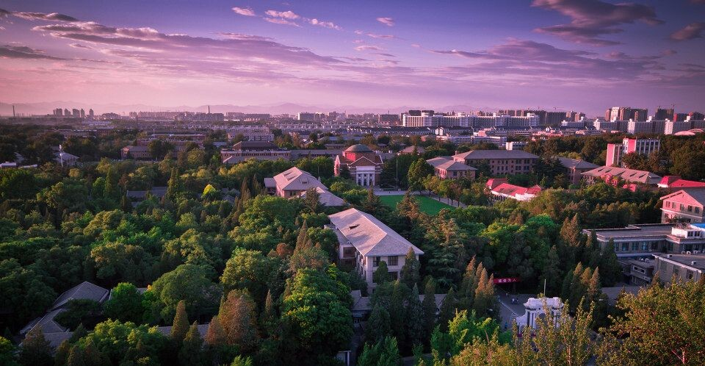
~ 5 km^2 campus
~ 3,860 Faculties
~ 16,000 Undergraduates
~ 43,000 Graduates

Slide 5
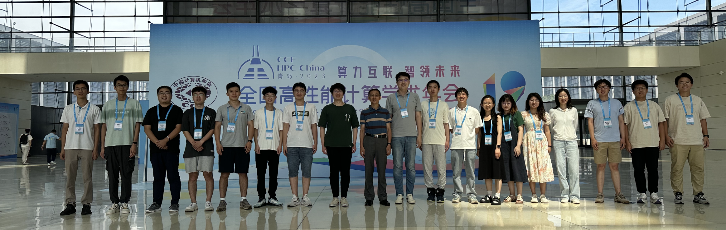
Tsinghua HPC Center
Solving numerical application with HPC &AI solutions
- Geoscience, CFD, MD, Quantum, etc.
- Homegrown, CPU, GPU, FPGAs, etc.
- Some national, regional, and university SC centers

Slide 6
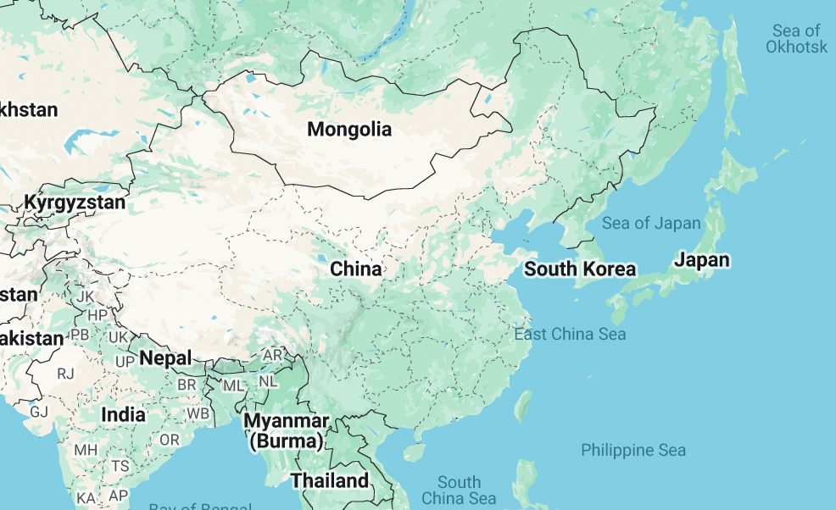
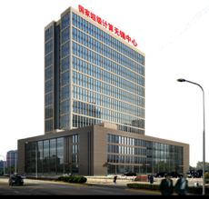

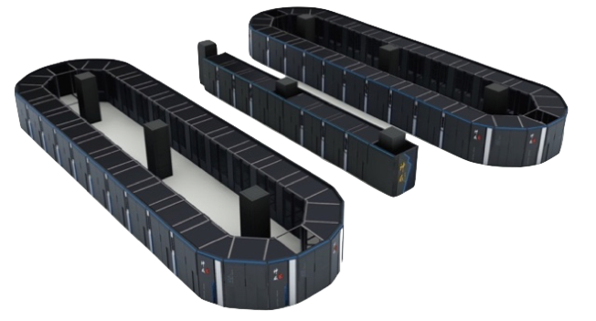
National Supercomputing Center in Wuxi
125P flops Sunway TaihuLight
No. 1 in TOP 500 in 2016, 2017
Taihu Lake

Slide 7


National Supercomputing Center in Wuxi
No. 1 per capital GDP in China
Taihu Lake

Slide 8
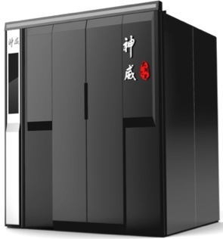
The Sunway TaihuLight Supercomputer
40x
4x
256
TaihuLight
Rack
Supernode
CPU
Homegrown CPU
Core Group / MPI
125Pflops Sunway TaihuLight
No. 1 in TOP 500 in 2016, 2017
10M cores

Slide 9
Extreme Scale Earthquake Simulation with Crossing Multi-faults and Topography
Background and Methods
Selected Supercomputer
Optimization Approaches
Performance and Earthquake Simulations
Conclusion

Slide 10
Extreme Scale Earthquake Simulation with Crossing Multi-faults and Topography
Background and Methods
Selected Supercomputer
Optimization Approaches
Performance and Earthquake Simulations
Conclusion

Slide 11
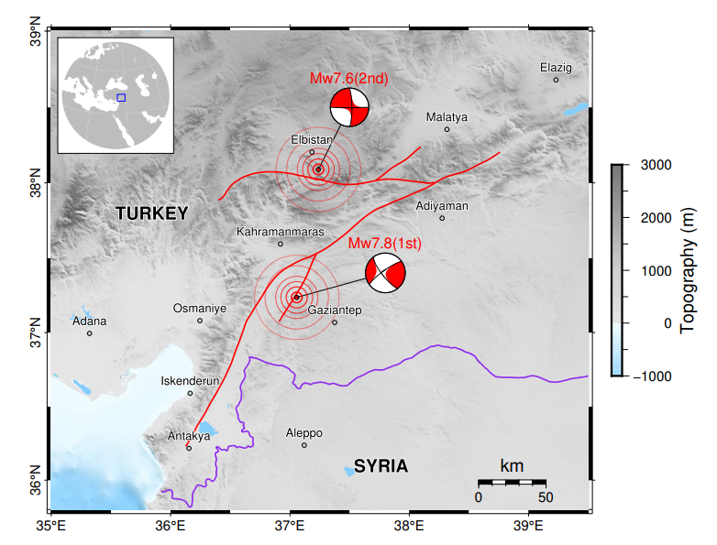
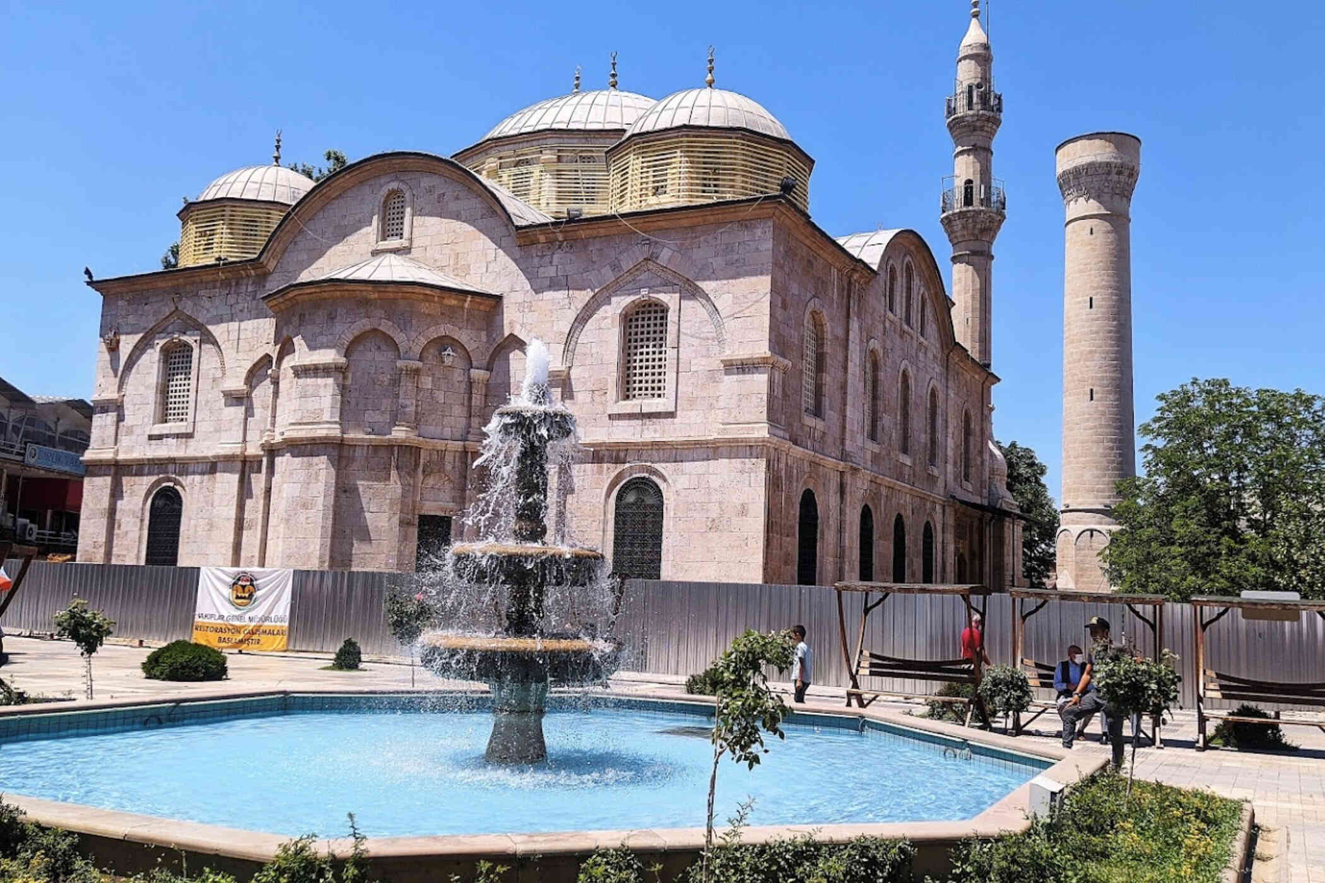
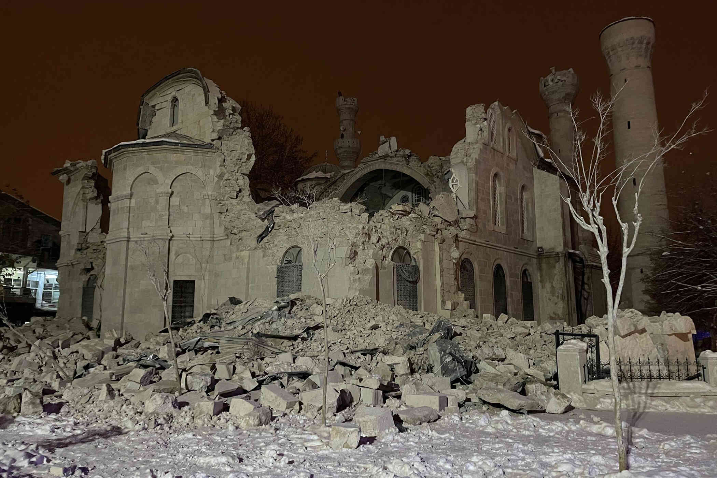
Earthquake: one of the most destructive disasters
Two events (𝑀𝑤 7.8 and 𝑀𝑤 7.6 ) of the 2023 Turkey earthquakes.
~ 59,259 deaths
~ US $118.8 billion
Notes:
Earthquakes are undoubtedly among the most destructive disaster that humankind has ever faced.
On February 6, this year, Turkey and Syria were struck by two large earthquakes, within, just nine hours. One is 7.8 Magnitude and anther is 7.6 Magnitude.
It is easy to imagine how much devastation these two large earthquakes could bring to the people of Turkey and Syria.
The confirmed deaths 59,259 and 121,704 injured, 297 missing.
Total damage more than $118.8 billion US dollar.
*** What we can do? ***

Slide 12
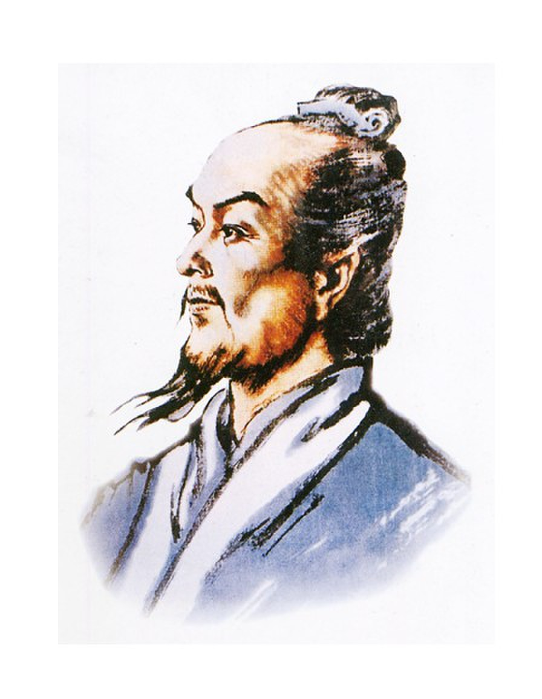
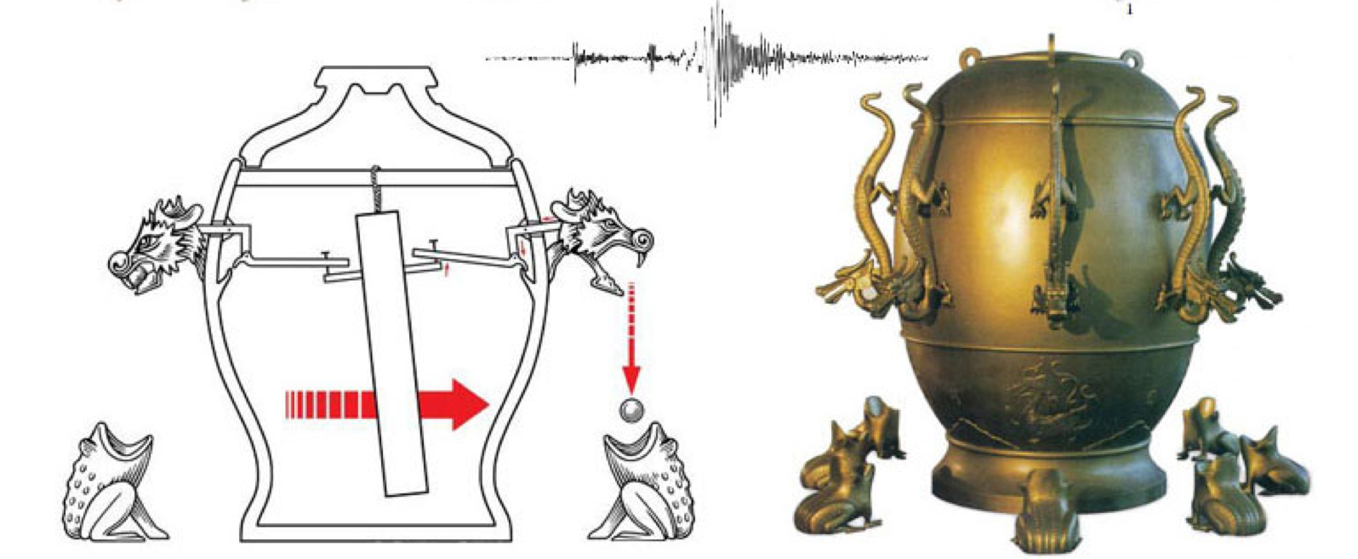
Understanding the Earthquake
A seismoscope by Heng Zhang (78-139 AD)
Notes:
The work in our paper aims to reduce the earthquake hazard and risk.
We are able to conduct high-resolution earthquake simulations promptly, and obtain the distribution of earthquake damage.
Then Guiding the earthquake rescue.

Slide 13
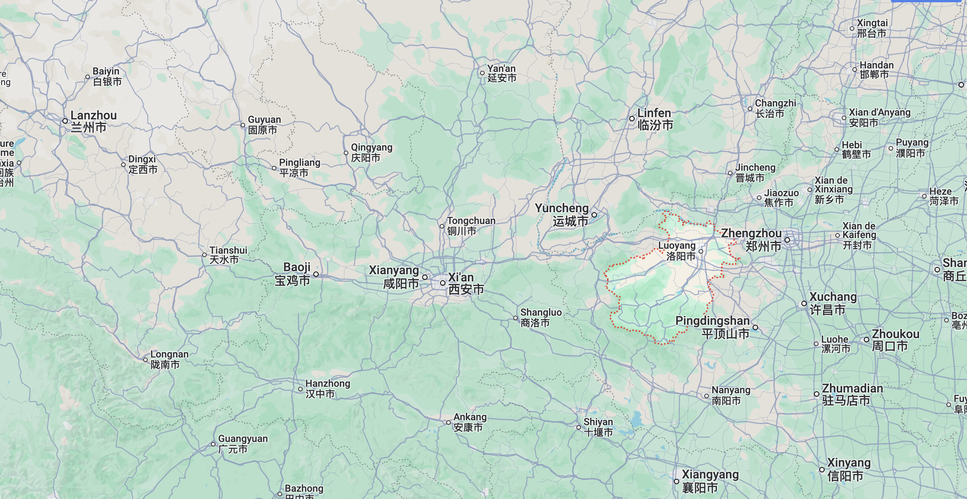
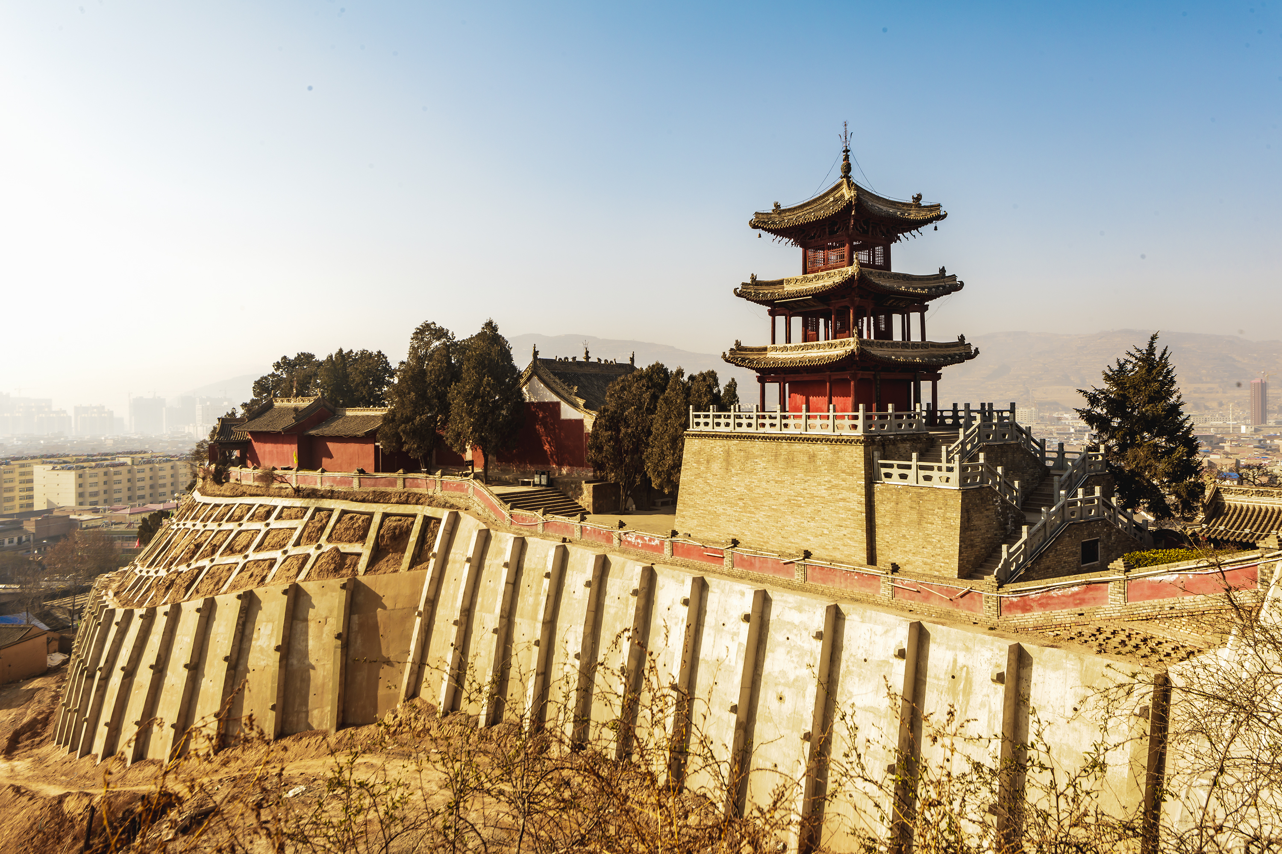
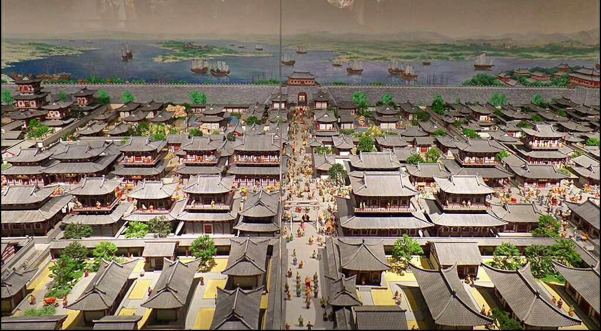
Understanding the Earthquake
Dec, 13, 134
> 600km

Slide 14
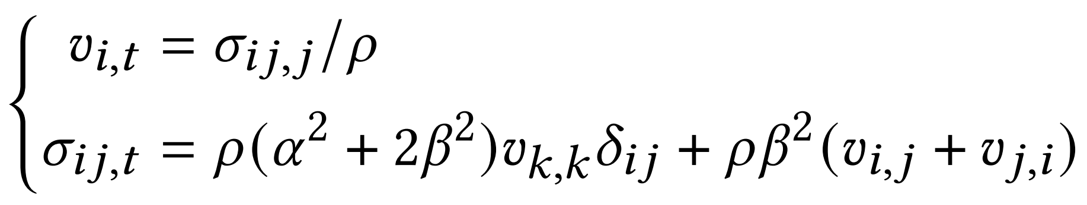
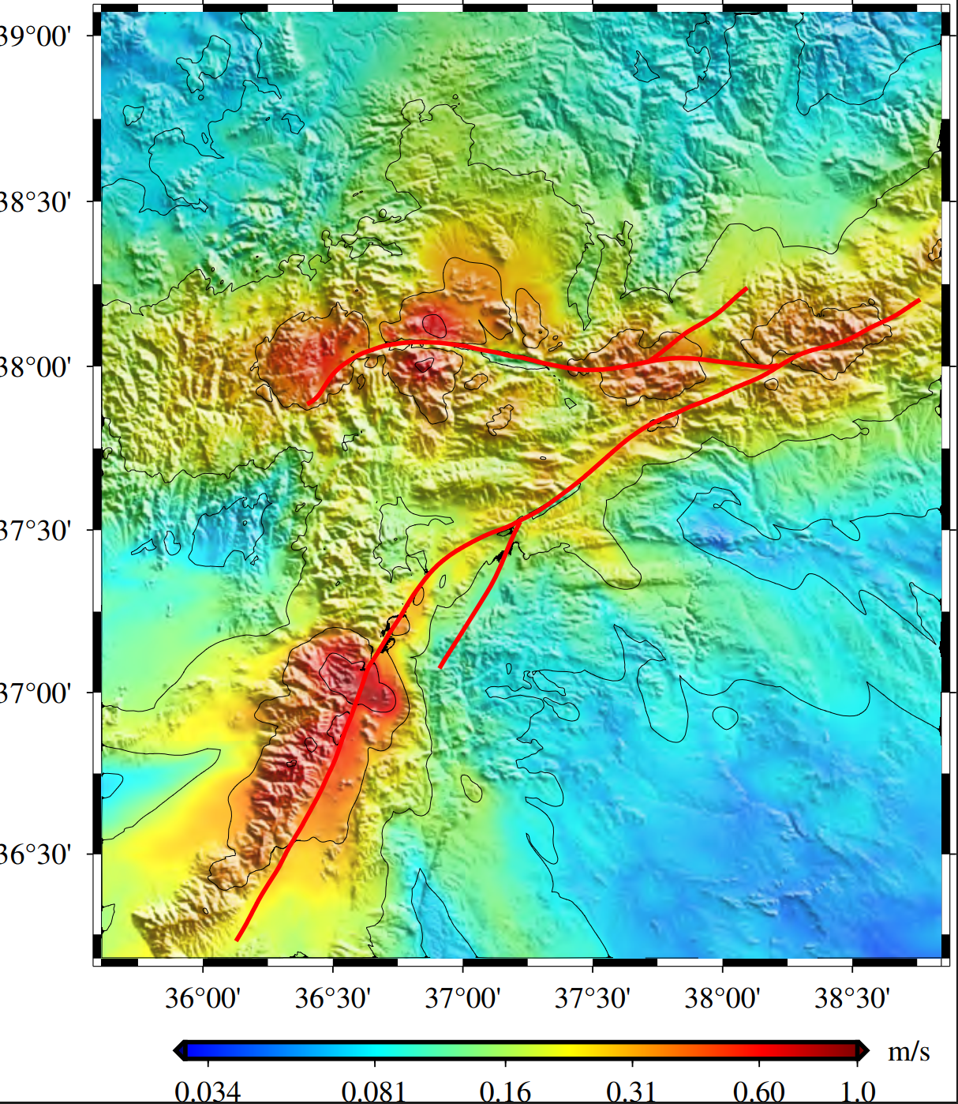
Understanding the Earthquake：Numerical Simulation
Wave Equation
Earthquake intensity
+
Supercomputer
Notes:
The work in our paper aims to reduce the earthquake hazard and risk.
We are able to conduct high-resolution earthquake simulations promptly, and obtain the distribution of earthquake damage.
Then Guiding the earthquake rescue.

Slide 15
Earthquake Simulation on Cutting-edge Supercomputers
Jaguar
Tianhe-2
K Computer
Titan
AWP-ODC
- 223,074 cores
- 220 Tflops
SeisSol
1.5m cores
8.6 Pflops
8 billion grids
GOJIRA
AWP-ODC
Gordon Bell Prize
- 8,192 GPUs
- 1.6 Pflops
- 663,552 cores
- 1.97 Pflops
-270 billion grids
non-linear
Gordon Bell Prize Finalists
AWP-ODC
non-linear
2012
- 10,million cores
- SW26010
- 18.9 Pflops
-7.8 trillion grids
Sunway
TaihuLight system
2010
SPECFEM3D
2014
2015
2017
- 896 GPUs
- 135 Tflops
2016
MOTHRA
2018
New Sunway
Cray XK6
202752CPUs
27648 V100
33.2Pflops
75 billion grids
CGFDM
Summit
AEGIS
UQ
- ﻿39 million cores
- ﻿SW26010Pro
- 69.7 Pflops
- 19.7 trillion grids
- ﻿7,312,896 cores
- ﻿48-core A64FX
- 18.9 Pflops
- 299 billion grids
- ﻿7,667,712 cores
- ﻿48-core A64FX
- 18.9 Pflops
- 3.7 trillion grids
ISUFE
202752CPUs
27648 Tesla V100
416 Pflops
2019
This work
Summit
2021-2022
Fugaku
Fugaku
Notes:
In recent years, there have been many impressive earthquake simulation projects on various supercomputing platforms.
We have listed our work and some of the state-of-the-art work on earthquake simulation.
We analyzed the advantages and disadvantages of these numerical methods.
Ultimately, we have adopted the Curvilinear Grid Finite Difference Method CGFD method to carry out large-scale earthquake simulations.
CGFDM inherits the traditional FDM properties of high accuracy and high efficiency.
It meshes grids flexibly according to the geometry of the calculation area.

Slide 16
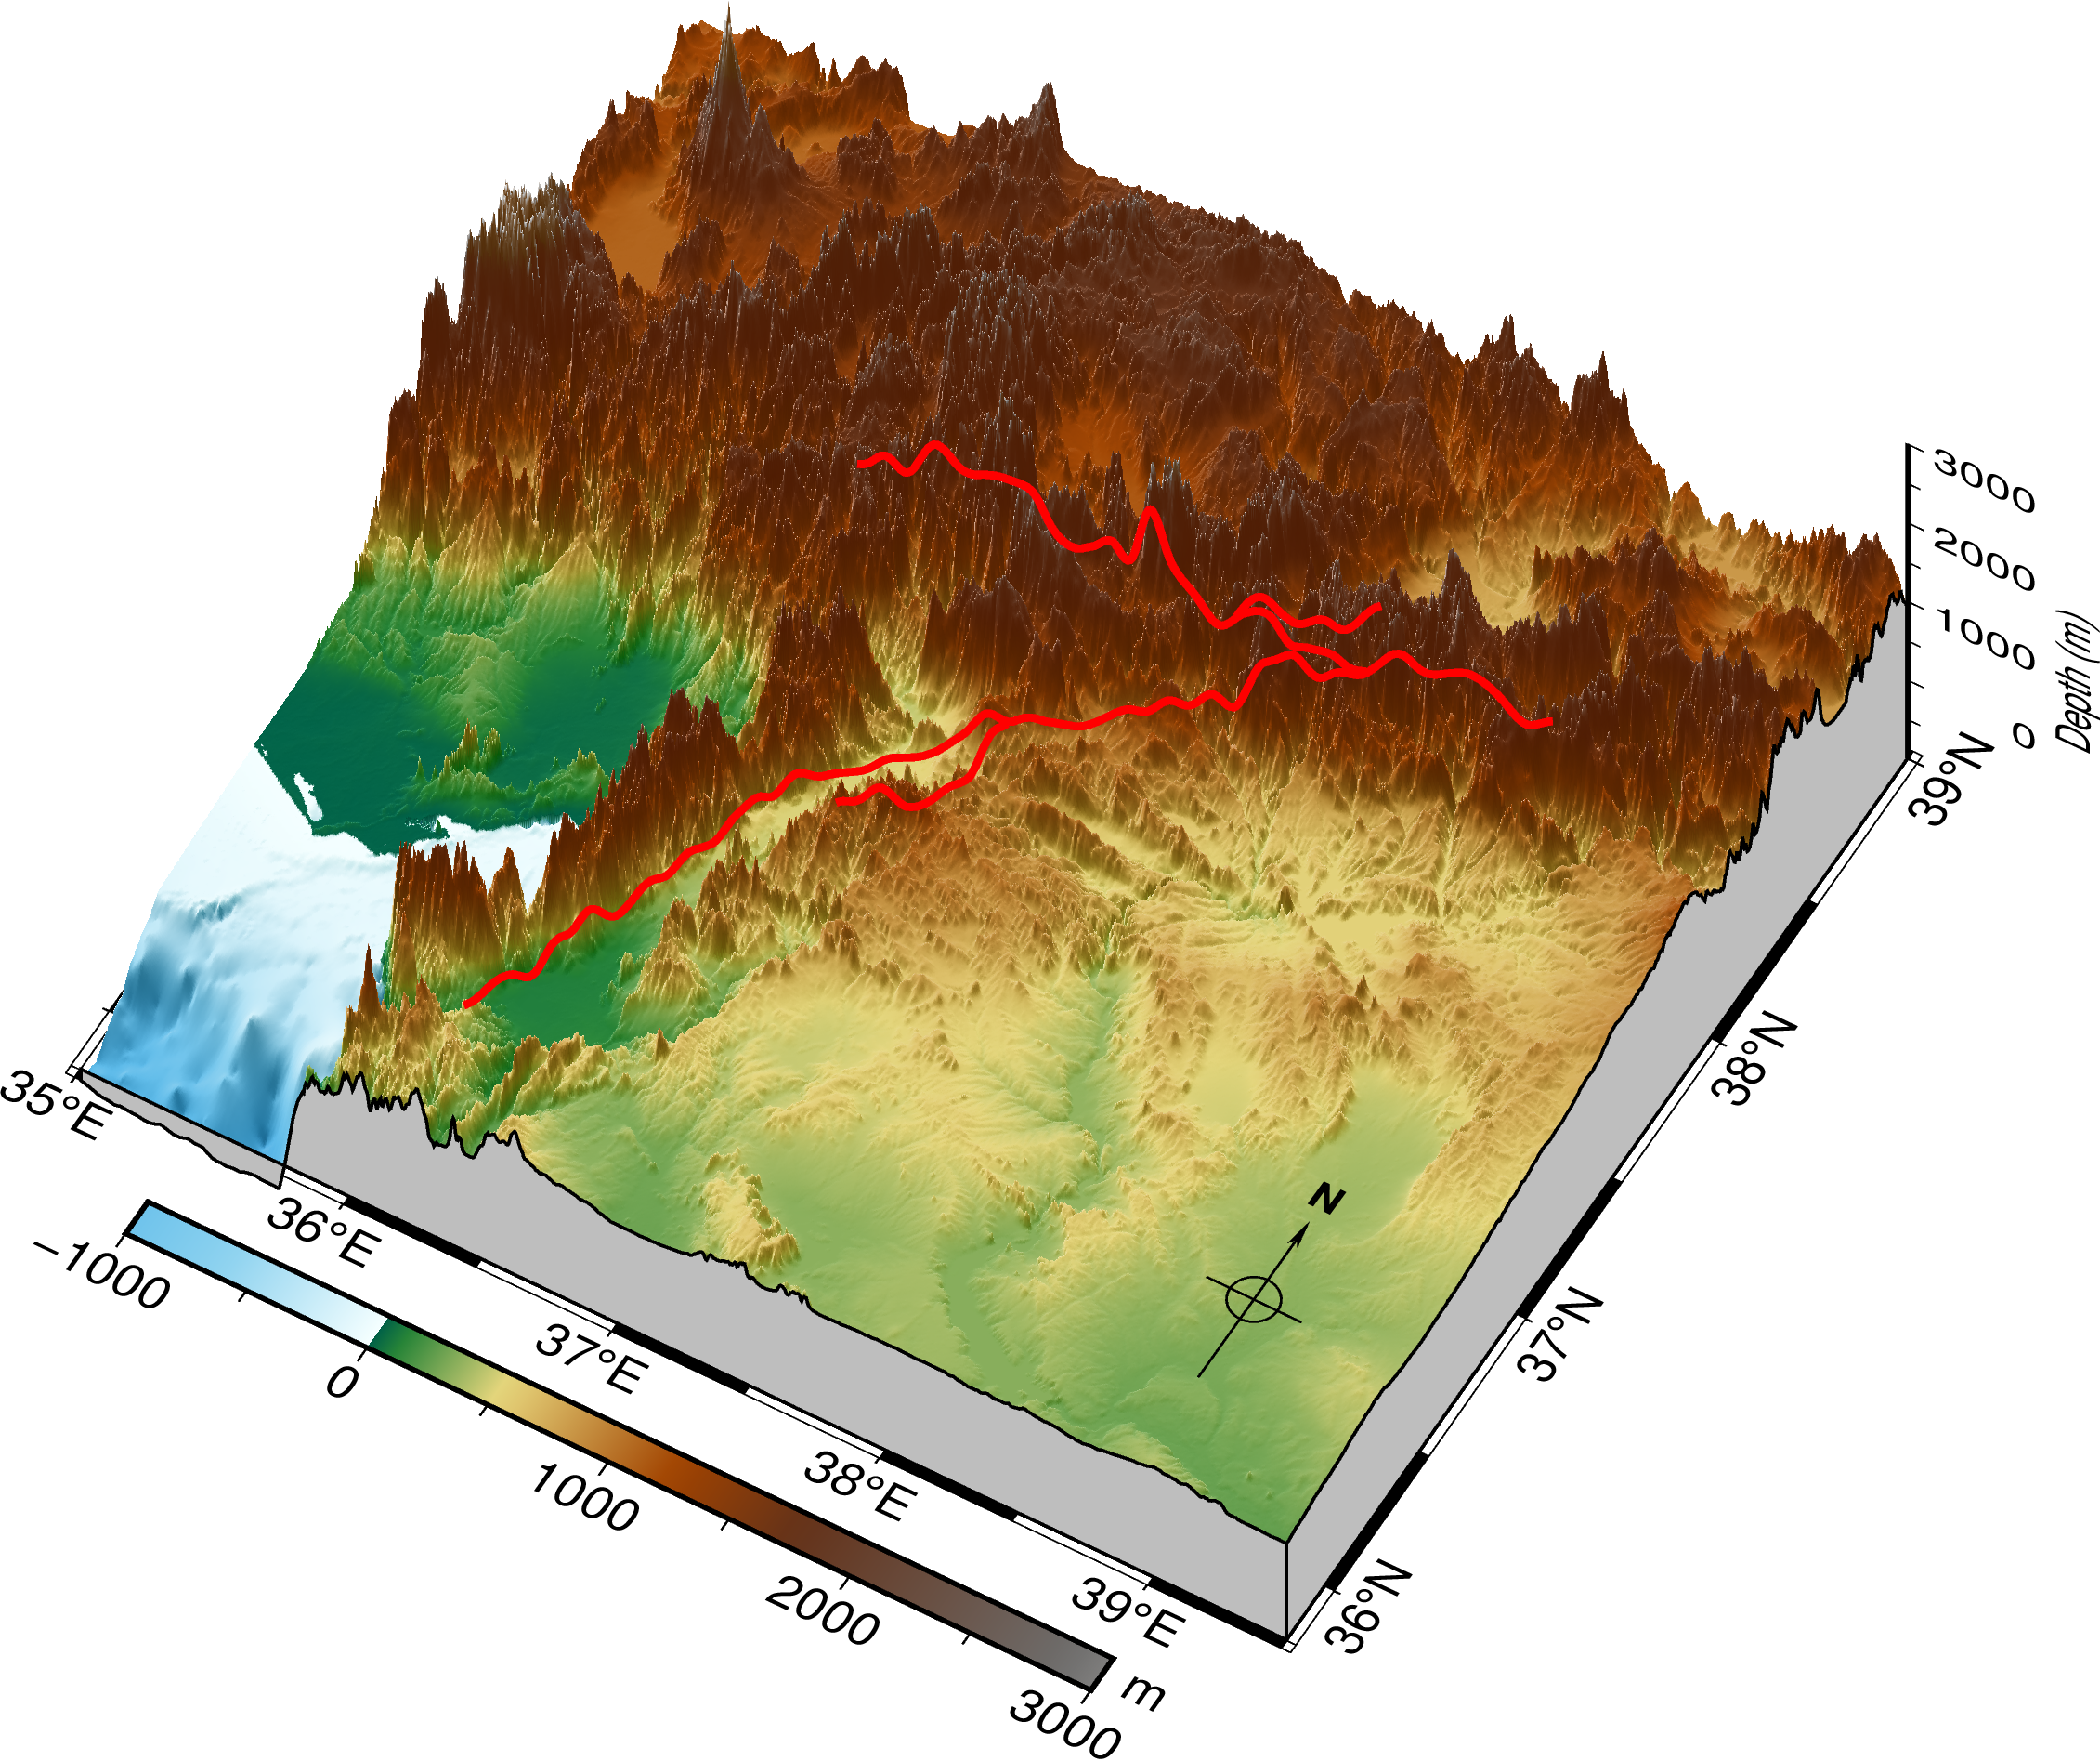
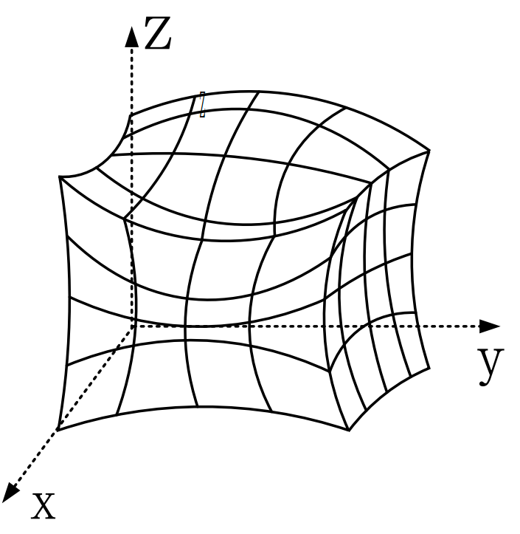
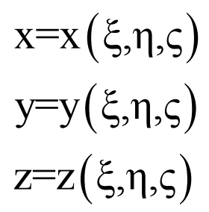
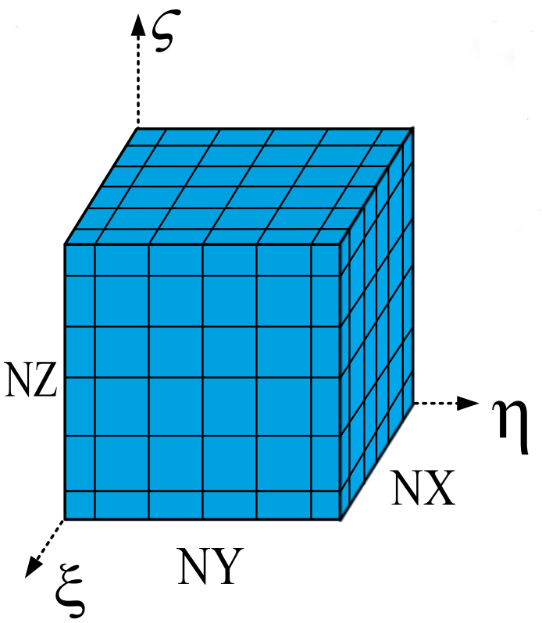
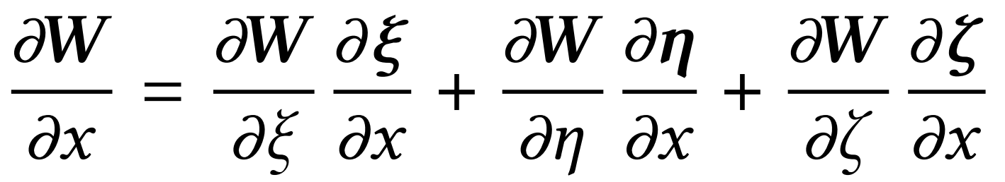
Curved-Grid and Equations
Coordinate Mapping from Physical Space to Computational Space.
discrete
transform
Simulation region
﻿physical space
﻿ calculation space
First-Order Velocity-Stress Elastic Wave Equation.
Thompson et al. (1985); Zhang et al. (2012)
Notes:
In recent years, there have been many impressive earthquake simulation projects on various supercomputing platforms.
We have listed our work and some of the state-of-the-art work on earthquake simulation.
We analyzed the advantages and disadvantages of these numerical methods.
Ultimately, we have adopted the Curvilinear Grid Finite Difference Method CGFD method to carry out large-scale earthquake simulations.
CGFDM inherits the traditional FDM properties of high accuracy and high efficiency.
It meshes grids flexibly according to the geometry of the calculation area.

Slide 17
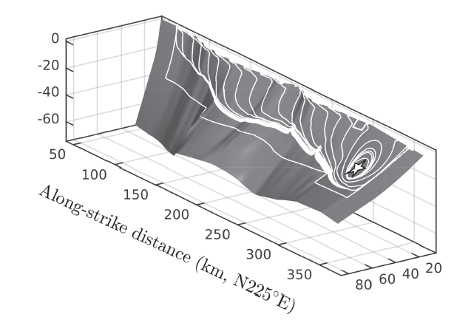
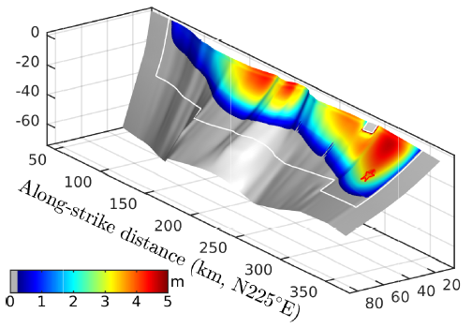
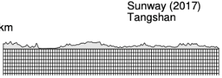
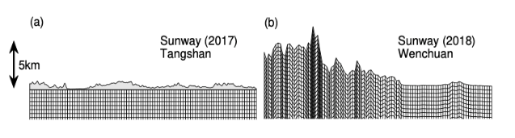
Curved-Grid and Dynamic Rupture Source
Dynamic rupture source
Tangshan
Wenchuan
Curved-Grid System
Notes:
In recent years, there have been many impressive earthquake simulation projects on various supercomputing platforms.
We have listed our work and some of the state-of-the-art work on earthquake simulation.
We analyzed the advantages and disadvantages of these numerical methods.
Ultimately, we have adopted the Curvilinear Grid Finite Difference Method CGFD method to carry out large-scale earthquake simulations.
CGFDM inherits the traditional FDM properties of high accuracy and high efficiency.
It meshes grids flexibly according to the geometry of the calculation area.

Slide 18

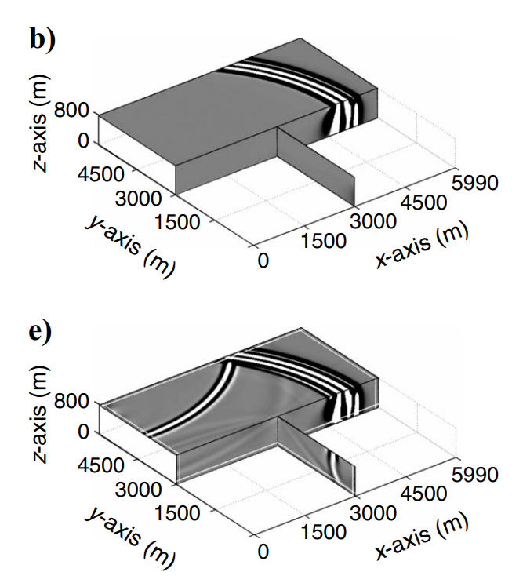
Perfectly Matched Layer (PML) for Boundary Condition
When seismic waves propagate to the boundary, they can generate spurious artificial reflection waves.
PML boundaries can eliminate spurious reflection waves, enabling complete seismic simulations and accurate calculations of seismic hazards.
Introducing additional computations, leading to severe load imbalance issues.
artificial reflection
Without PML
With PML
The three-dimensional PML absorbing boundary condition
Notes:
For an earthquake hazard evaluation, it is crucial to accurately model wave propagation.
However, When seismic waves propagate to the boundary, they can generate spurious artificial reflection waves.
This significantly impacts the accuracy and completeness of earthquake simulation.
The PML technique can effectively reduce artificial reflections and significantly improve the precision of earthquake simulations.
Therefore, the PML is employed in our study.
﻿However, the PML is only distributed on the surface layer of the entire computing process cube and required more calculations.
This results in severe load imbalance issues.

Slide 19
Overview of this work
Dynamic rupture source
With PML
Supercomputer
The three-dimensional PML absorbing boundary condition
Notes:
For an earthquake hazard evaluation, it is crucial to accurately model wave propagation.
However, When seismic waves propagate to the boundary, they can generate spurious artificial reflection waves.
This significantly impacts the accuracy and completeness of earthquake simulation.
The PML technique can effectively reduce artificial reflections and significantly improve the precision of earthquake simulations.
Therefore, the PML is employed in our study.
﻿However, the PML is only distributed on the surface layer of the entire computing process cube and required more calculations.
This results in severe load imbalance issues.

Slide 20
Outline
Background and Methods
Selected Supercomputer
Optimization Approaches
Performance and Earthquake Simulations
Conclusion

Slide 21
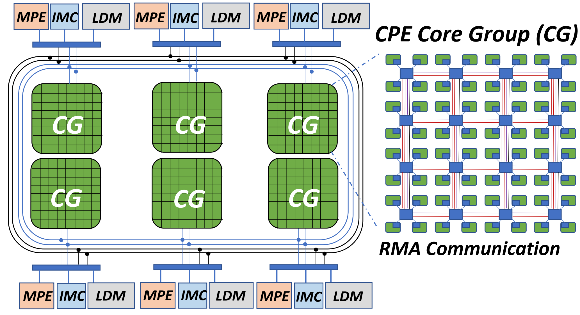
The New Sunway System/ The Next-Generation Sunway
Management processing element (MPE).
Computing processing element (CPE).
Core-groups (CGs) = 1*MPE+64*CPE, 6CGs=390*processor
Each CPE provides an RMA communication mechanism for exchanging data with other CPEs.
﻿The architecture of SW26010Pro.
Notes:
Our work was carried out on China's latest Sunway supercomputer, which is powered by the SW26010Pro many-core architecture chips.
SW26010Pro CPU consists of 6 core-groups (CGs), with each CG integrating one management processing element (MPE) and one computing processing element (CPE) cluster, comprising 8×8 CPEs.
each CPE has fast and low-latency 256KB local data memory (LDM). Moreover, each CPE has its own instruction pipeline and a 32 KB L1 instruction cache and supports 512-bit SIMD instructions. The peak memory bandwidth between DDR4 main memory and each CG is about 48GB/s.
Within a CPE cluster, each CPE provides an RMA communication mechanism for exchanging data with other CPEs. The RMA operation has lower latency and higher bandwidth than the DMA operation.

Slide 22
Outline
Background and Methods
Selected Supercomputer
Optimization Approaches
Performance and Earthquake Simulations
Conclusion

Slide 23

I. Process-level Optimization Approaches
Hybrid Domain Decomposition Scheme
Overlapping Strategies
Notes:
In the upcoming time, I will provide a detailed explanation of these optimization methods.

Slide 24
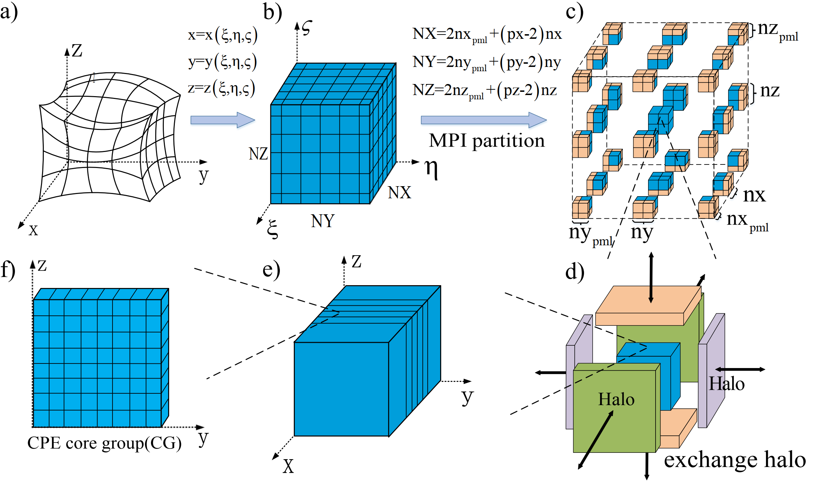
Hybrid Domain Decomposition Scheme
- The curvilinear grids transformed into regular computational space.
- The computational space was decomposed into several subdomains.
- Each sub-domain is decomposed to one core group (CG).
Notes:
﻿To achieve high scalability and efficiency in seismic simulation, we propose a hybrid domain decomposition scheme.
We dis`cretize irregular geometries onto a curvilinear grids, and the curvilinear grids are transformed into regular computational space.
The computational space was decomposed into several subdomains in processes, then each sub-domain is decomposed to one core group (CG).

Slide 25
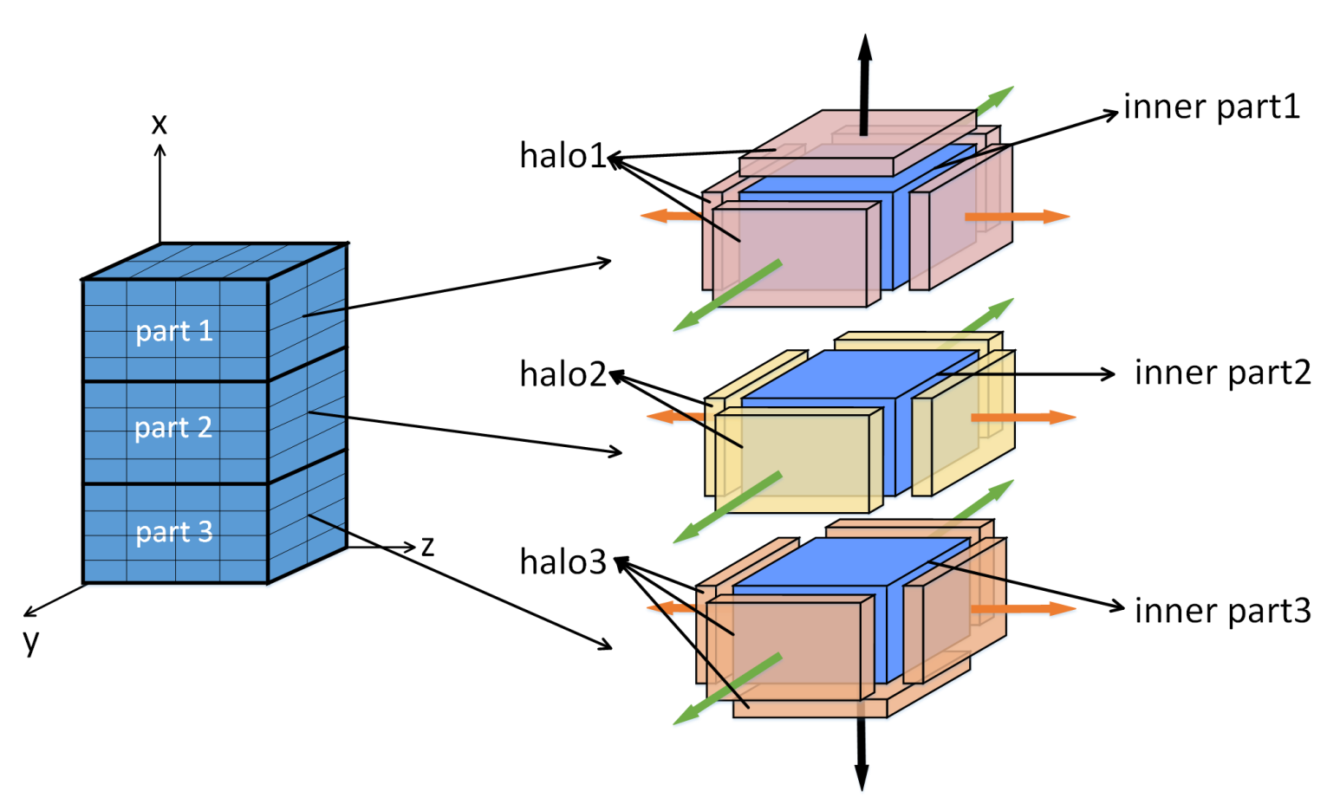
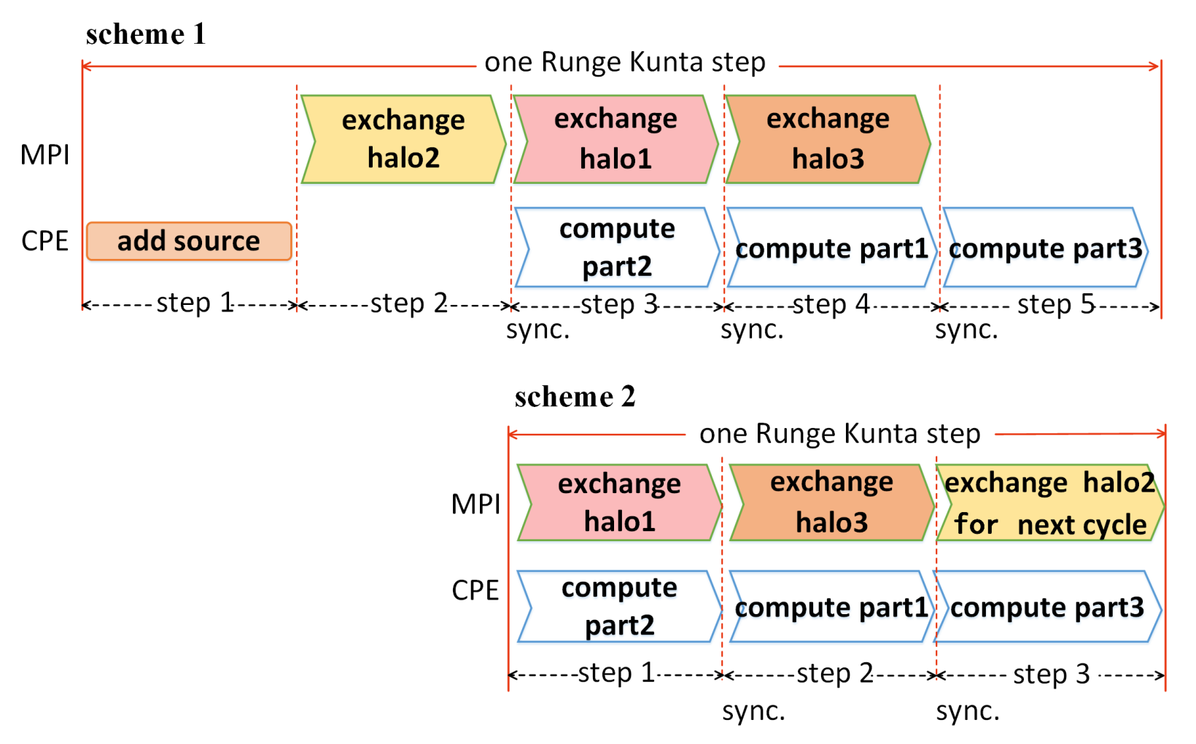
Overlapping Strategies
Improve the computational efficiency of seismic simulations
﻿The sub-domain in a process is divided into three parts for overlapping.
﻿The asynchronous communication workflow for overlapping.
Notes:
Considering that the computation and communication in CGFDM can be appropriately decoupled.
Then,we can design overlapping schemes to improve the computational efficiency of seismic simulations.
In traditional way, we have decomposed the entire domain into seven computing regions comprising of six halo parts and one inner computing part.
To achieve computation and communication overlapping, we typically complete the computation of the six halo regions first and then use asynchronous MPI communication to exchange halo data while computing the inner region.
Unfortunately, In typical 3D finite-difference calculations, discontinuous memory access problems exist in the halo regions.
especially, using an accelerator card to update halo.
To further optimize, we propose another overlapping scheme.
We decompose the grid sub-domain in a process into three parts, and design a workflow that utilizes the computation and communication of each part to achieve overlapping.
The halo and inner parts of the grids are transferred to the CPE for computing as a whole,
So in this way the problem of discontinuous memory access is avoid.
Additionally, in our earthquake simulation, seismic sources are only required in the initial simulation steps to update the data.
In the later stages of the simulation, seismic sources are unnecessary, enabling us to achieve complete overlapping.

Slide 26
﻿Domain Size | ﻿Scheme | ﻿COMP Time(s) | ﻿COMM Time(s) | ﻿Performance ﻿Improvement
﻿2000 × 2000 × 800 | ﻿OVLP | ﻿756.582 | ﻿28.953 | ﻿18.81%
 | ﻿NOVLP | ﻿574.056 | ﻿393.564
﻿2000 × 2000 × 200 | ﻿OVLP | ﻿367.195 | ﻿15.288 | ﻿23.06%
 | ﻿NOVLP | ﻿296.784 | ﻿200.392
﻿1600 × 1400 × 200 | ﻿OVLP | ﻿218.512 | ﻿9.329 | ﻿29.26%
 | ﻿NOVLP | ﻿185.091 | ﻿137.039
﻿1400 × 1600 × 200 | ﻿OVLP | ﻿224.449 | ﻿9.157 | ﻿23.63%
 | ﻿NOVLP | ﻿167.614 | ﻿138.289
﻿1400 × 200 × 1600 | ﻿OVLP | ﻿177.443 | ﻿9.337 | ﻿18.25%
 | ﻿NOVLP | ﻿91.035 | ﻿137.386
﻿1000 × 1000 × 1000 | ﻿OVLP | ﻿217.922 | ﻿7.429 | ﻿26.43%
 | ﻿NOVLP | ﻿196.260 | ﻿110.059
﻿700 × 800 × 200 | ﻿OVLP | ﻿67.142 | ﻿2.973 | ﻿34.20%
 | ﻿NOVLP | ﻿43.363 | ﻿63.293
Notes:
To demonstrate the significant performance improvement achieved by our overlapping scheme.
We conducted several different earthquake simulation cases.
This table illustrates the performance improvement achieved by our overlapping scheme. In this table, 'OVLP' represents the overlapping scheme, 'NOVLP' represents the non-overlapping scheme, and 'COMP' stands for computing time. COMM stands for communication time.
﻿And, results indicate that our overlapping scheme performs well.

Slide 27
II. Thread-level Optimization Approaches
Decomposition
Vectorization
RMA Communication
﻿Error-bounded Lossy Compression with SWSZx

Slide 28
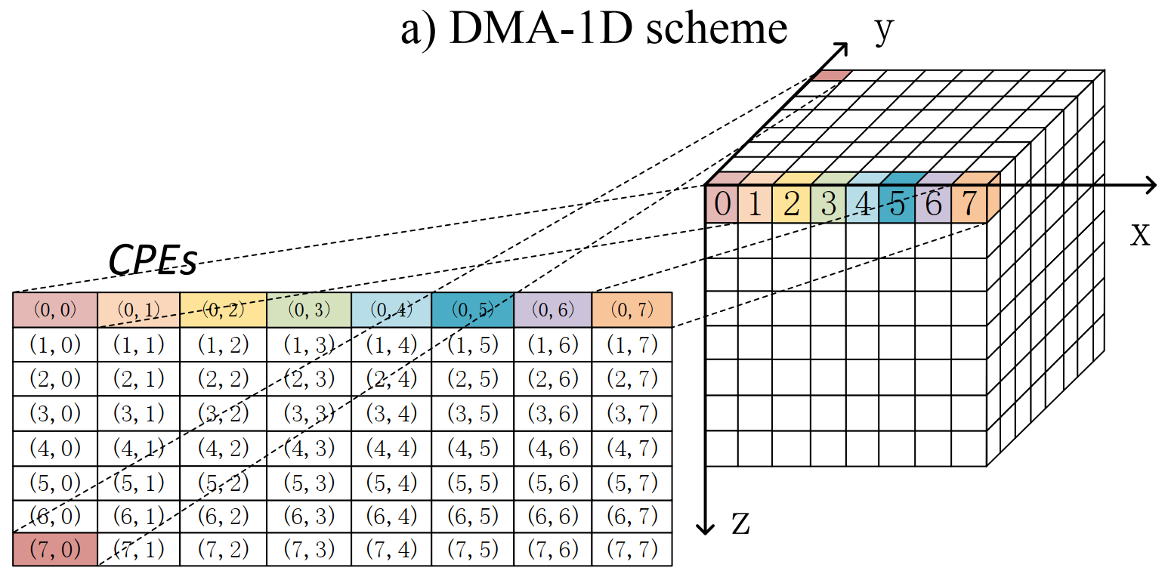


Thread-level Decomposition
﻿To fully exploit the computing power of CPEs and the low latency of LDM, the sub-domain grids in each process should be further decomposed to fit within the LDM.
y
Secondary decompose of the computational domain.
z
x
Notes:
To fully exploit the computing power of CPEs and the low latency of LDM,
the sub-domain grids in each process should be further decomposed into CPE.
And using DMA pumping data in and out between main memory and LDM in CPE.

Slide 29
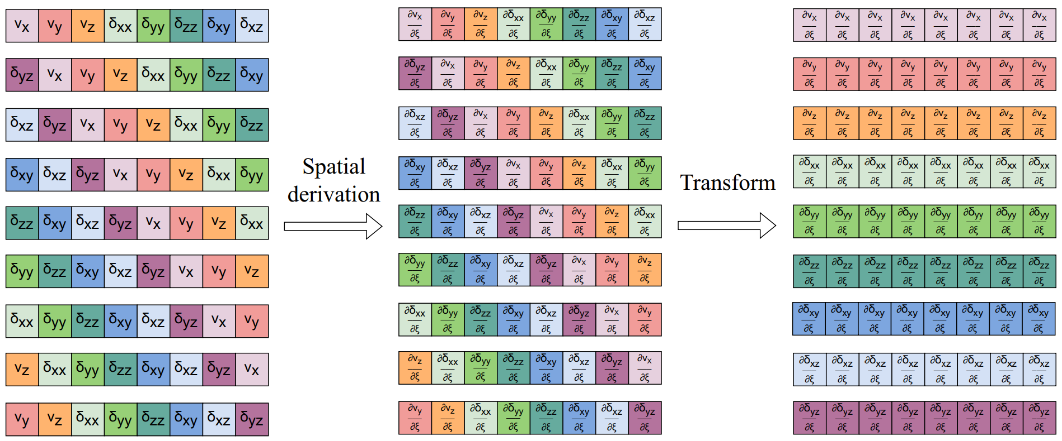
Vectorization
﻿CPE cores offer comprehensive support for SIMD ﻿instructions.
﻿Each CPE features a 512-bit vector processing unit capable of executing 8 elements.
﻿9 components in the wave field variable 𝑊 perform the same operations.
﻿Input array as multiple 1-D blocks, with each block consisting of 8 × 9 elements.
﻿The spatial derivation array of each block is reorganized to an 8 × 9 array.
﻿The memory layout of 8 × 9 elements for vectorization.
﻿ Nine components in the wave field variable 𝑊 perform the same operations when calculating the spatial derivatives.
﻿ Input array as multiple 1-D blocks, with each block consisting of 8 × 9 elements.
﻿The spatial derivation array of each block is reorganized to an 8 × 9 array.
Notes:
The CPE in SW26010Pro processors offer SIMD instructions, 512-bit vector processing unit, can execute 8 single or double precision floating-point numbers in a single instruction.
Considering that, nine components in the wave field variable 𝑊 perform the same operations when calculating the spatial derivatives.
We reorganize the wave variable array to an 8*9 array for SIMD instructions.

Slide 30
Remote Memory Access (RMA)
Each CPE inside one CG to exchangee data with other CPEs.
Boundary Exchange
On-the-fly Matrix Transposition
Pack and Send
communication
Matrix-Matrix Multiplication
﻿The architecture of SW26010Pro.
Notes:
Our work was carried out on China's latest Sunway supercomputer, which is powered by the SW26010Pro many-core architecture chips.
SW26010Pro CPU consists of 6 core-groups (CGs), with each CG integrating one management processing element (MPE) and one computing processing element (CPE) cluster, comprising 8×8 CPEs.
each CPE has fast and low-latency 256KB local data memory (LDM). Moreover, each CPE has its own instruction pipeline and a 32 KB L1 instruction cache and supports 512-bit SIMD instructions. The peak memory bandwidth between DDR4 main memory and each CG is about 48GB/s.
Within a CPE cluster, each CPE provides an RMA communication mechanism for exchanging data with other CPEs. The RMA operation has lower latency and higher bandwidth than the DMA operation.

Slide 31
Error-bounded Lossy Compression with SWSZx
﻿RMA-based method is not very beneficial for the read-only geometry and medium parameters.
﻿﻿Since 𝑀 is read-only, we can compress 𝑀 once and then decompress the corresponding data blocks in each CPE.
𝑀 is smooth in space, we reorganized the memory layout of 𝑀 as multiple 1-D blocks.
﻿We implemented an ultra-fast error-bounded lossy compression framework SWSZx.
CPE
compute functions
decompress
256 KB LDM
DMA
pumping more data in and out
DDR MEM (data in compressed form)
Notes:
Considering that, RMA-based method is not very beneficial for the read-only geometry and medium parameters. Parameters array 𝑀 is read-only. And 𝑀 is smooth in space.
Based on these characteristics,
We implemented an ultra-fast error-bounded lossy compression framework SWSZx.
We use SWSZx compress/decompress M.
Then we can pumping more date in and out.

Slide 32
III. Load Balancing: Non-uniform Decomposition

Slide 33
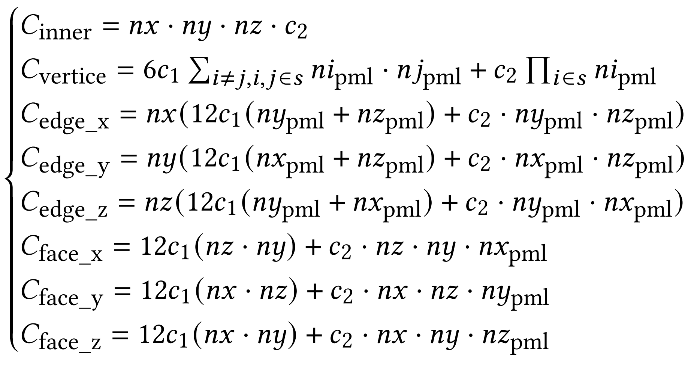
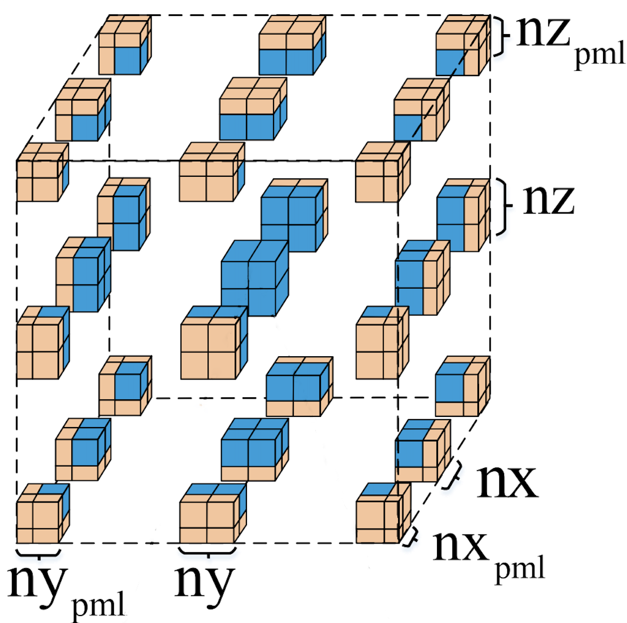
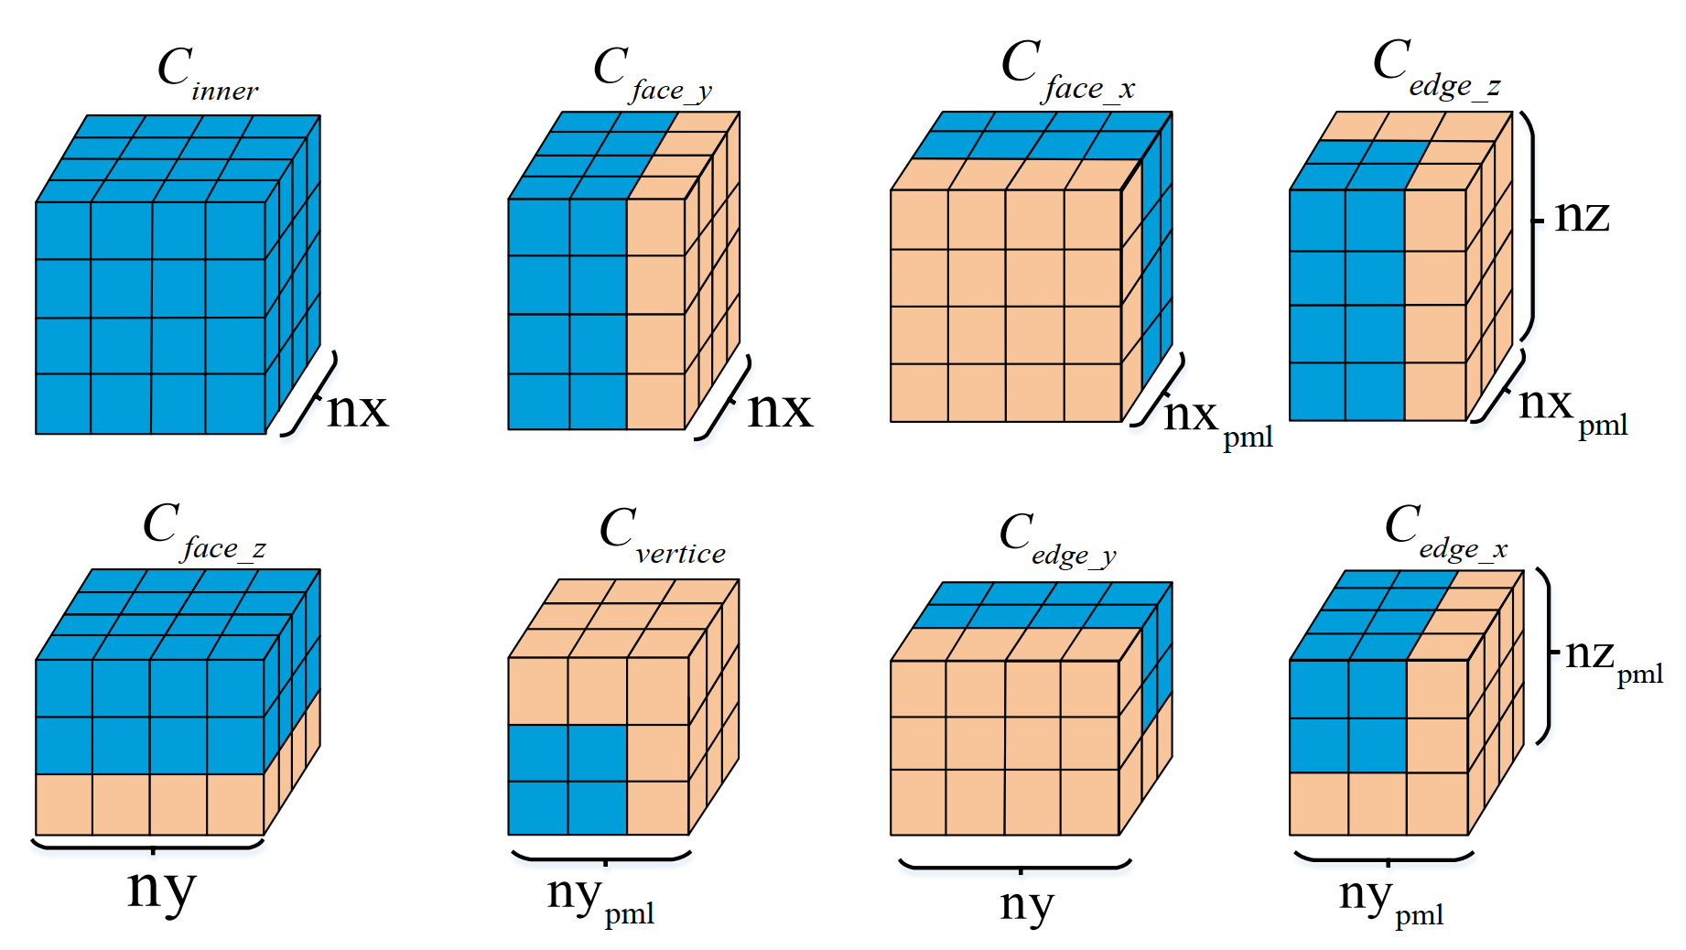
Non-uniform Decomposition
Quantitative analysis of the computational load for different processes. Minimizing the maximum value of 𝐶.
To find the optimal computation load distribution.
Notes:
As mentioned in the previous slides, the PML is only distributed on the surface layer of the entire computing process cube and required more calculations.
So, every processes has different computing workload. This leads to severe load imbalance issue in our program.
To address this problem, we have adopted the most intuitive approach.
All processes are classified into eight different types based on their positions.
Then, we quantitatively analyzed the computational workload of all processes.
Minimizing the maximum workload of all processes. To find the optimal computation load distribution.

Slide 34
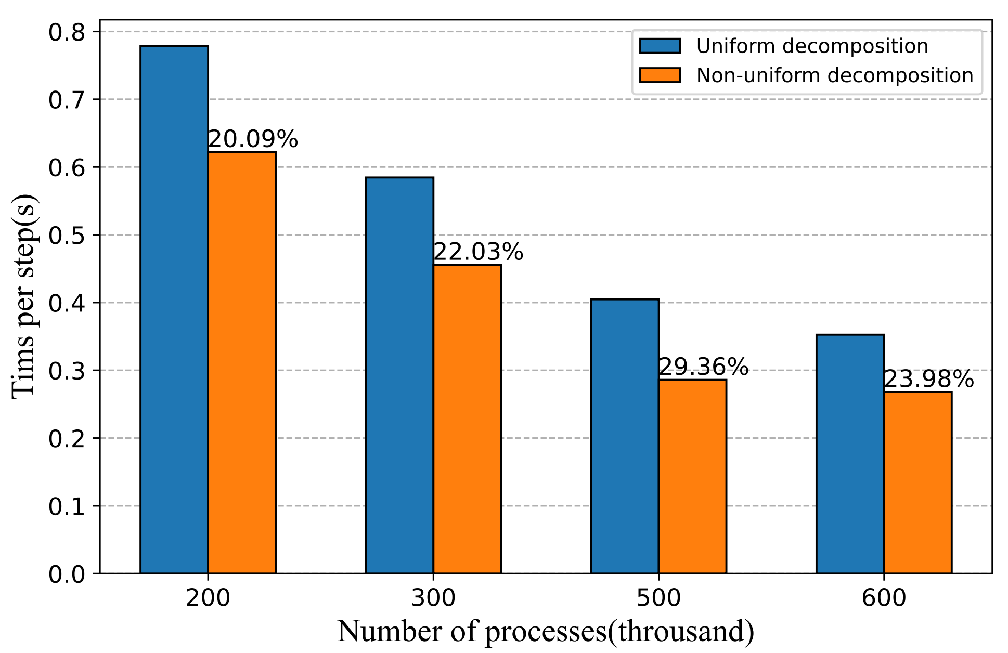
Non-uniform Decomposition
﻿Performance comparison of uniform and nonuniform decomposition methods.
Notes:
This figure shows that ﻿our non-uniform decomposition method has achieved a remarkable performance improvement ﻿in large-scale simulations.

Slide 35
Outline
Background and Methods
Selected Supercomputer
Optimization Approaches
Performance and Earthquake Simulations
Conclusion

Slide 36
I. Performance Results
Time to Solution
Weak Scalability
Strong Scalability

Slide 37
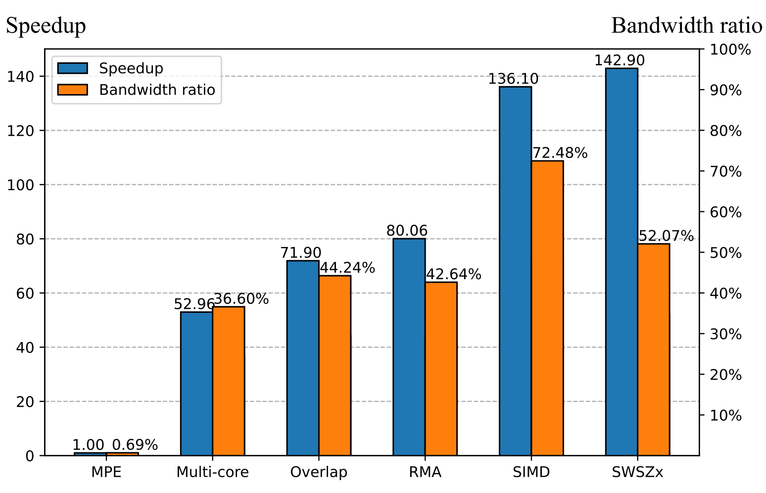
Time-to-Solution
﻿Step-by-step speedups and bandwidth ratio for different optimization methods in the wave propagation kernel.
Notes:
This figure shows ﻿ step-by-step speedups and bandwidth ratios ﻿for various optimization methods.
﻿By integrating all these optimization techniques, we achieved more than 142× speedups compared to the original version.

Slide 38
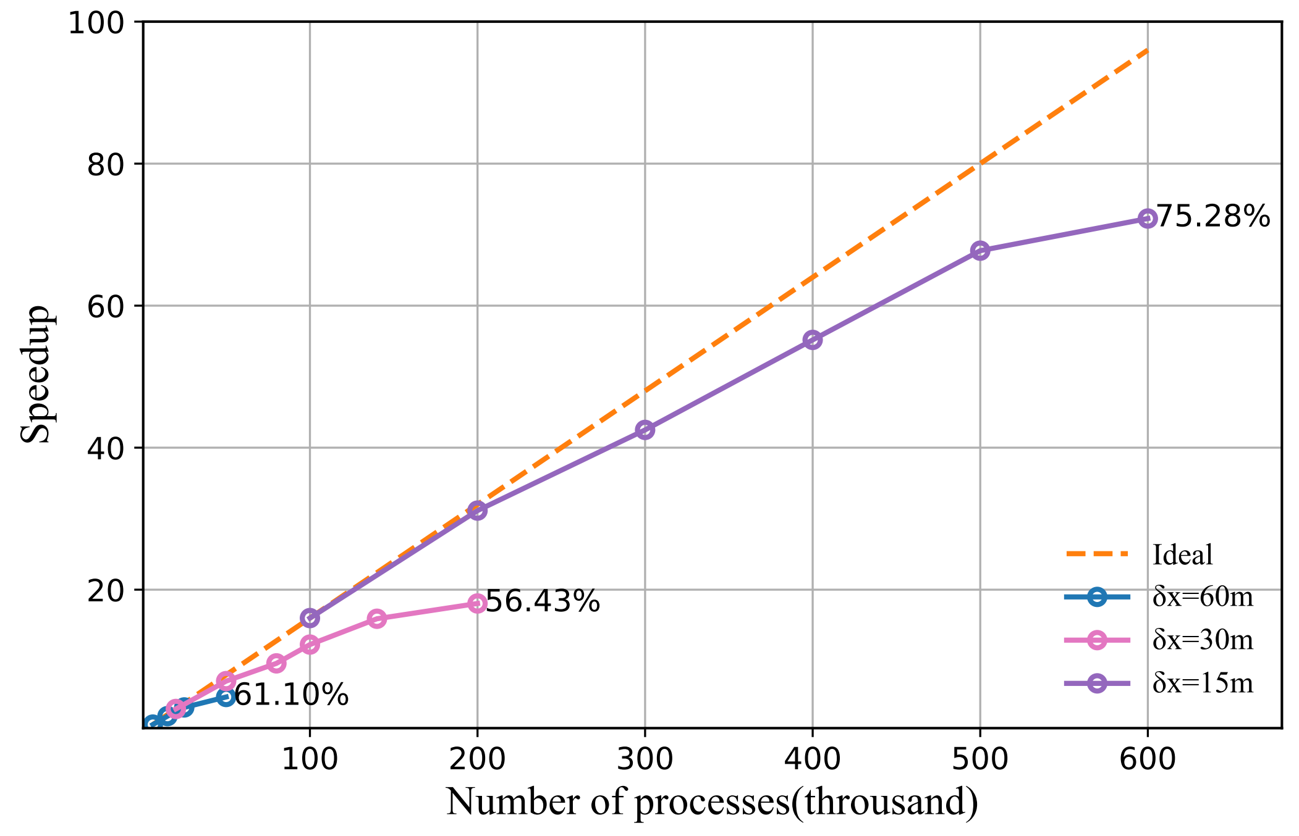
Strong Scalability
Turkey earthquake simulation in 15m, 30m, and 60m resolutions.
Test scales from 6,250 to 600,000 MPI processes
Notes:
﻿the strong scaling test results for 15m, 30m, and 60m，Ridgecrest earthquake simulations. Notably, we achieved a strong scaling parallel efficiency of 75.28% when increasing the number of processes from 100,000 to 600,000.
As anticipated, there is scalability degradation with the increase in MPI processes.
The primary cause for this decline in efficiency is the decreasing ratios of computation to communication and outer halo region to sub-domain size.
These reductions contribute to an enlarged computation overhead, making our software less efficient.

Slide 39
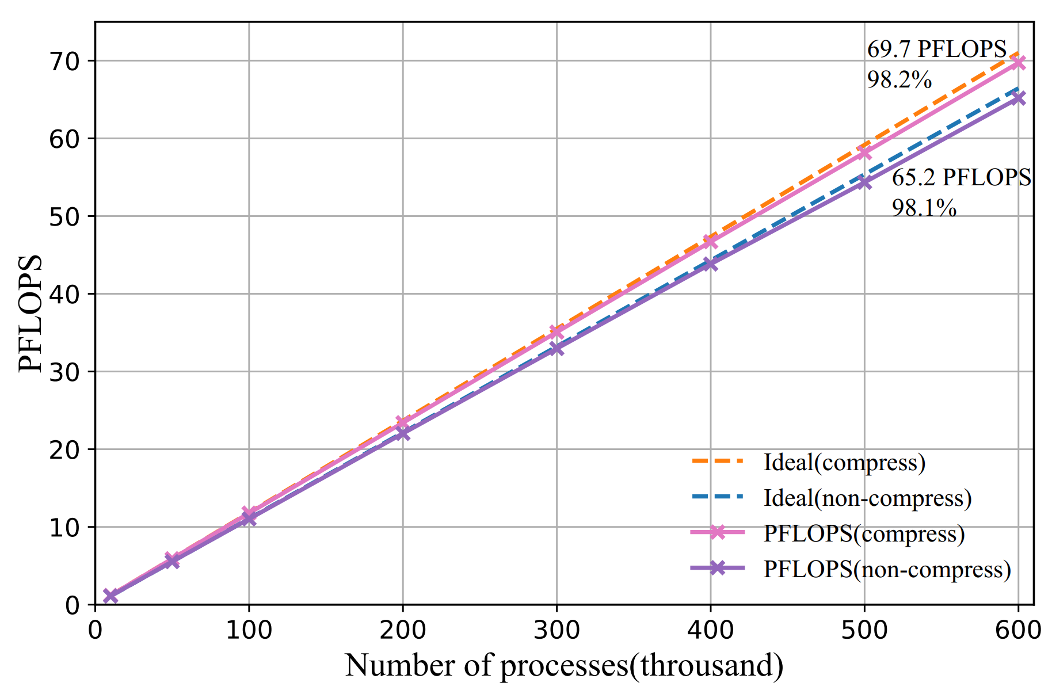
Weak Scalability
﻿Starting from 10,000 up to 600,000 processes, 15-m resolution
Tested in both compress and non-compress versions
39M cores
69.7PFlops
98.2%
Notes:
﻿This figure shows a near-linear speedup when scaling from 10,000 processes to 600,000 processes.
For the compress version, we achieved peak sustained performance of 69.7 PFLOPS with a parallel efficiency of 98.2%.
For the non-compress version, we achieved peak sustained performance of 65.2 PFLOPS with a parallel efficiency of 98.1%.

Slide 40
Earthquake Simulations
Ridgecreset Earthquake
Turkey Earthquakes
Wenchuan Earthquake

Slide 41
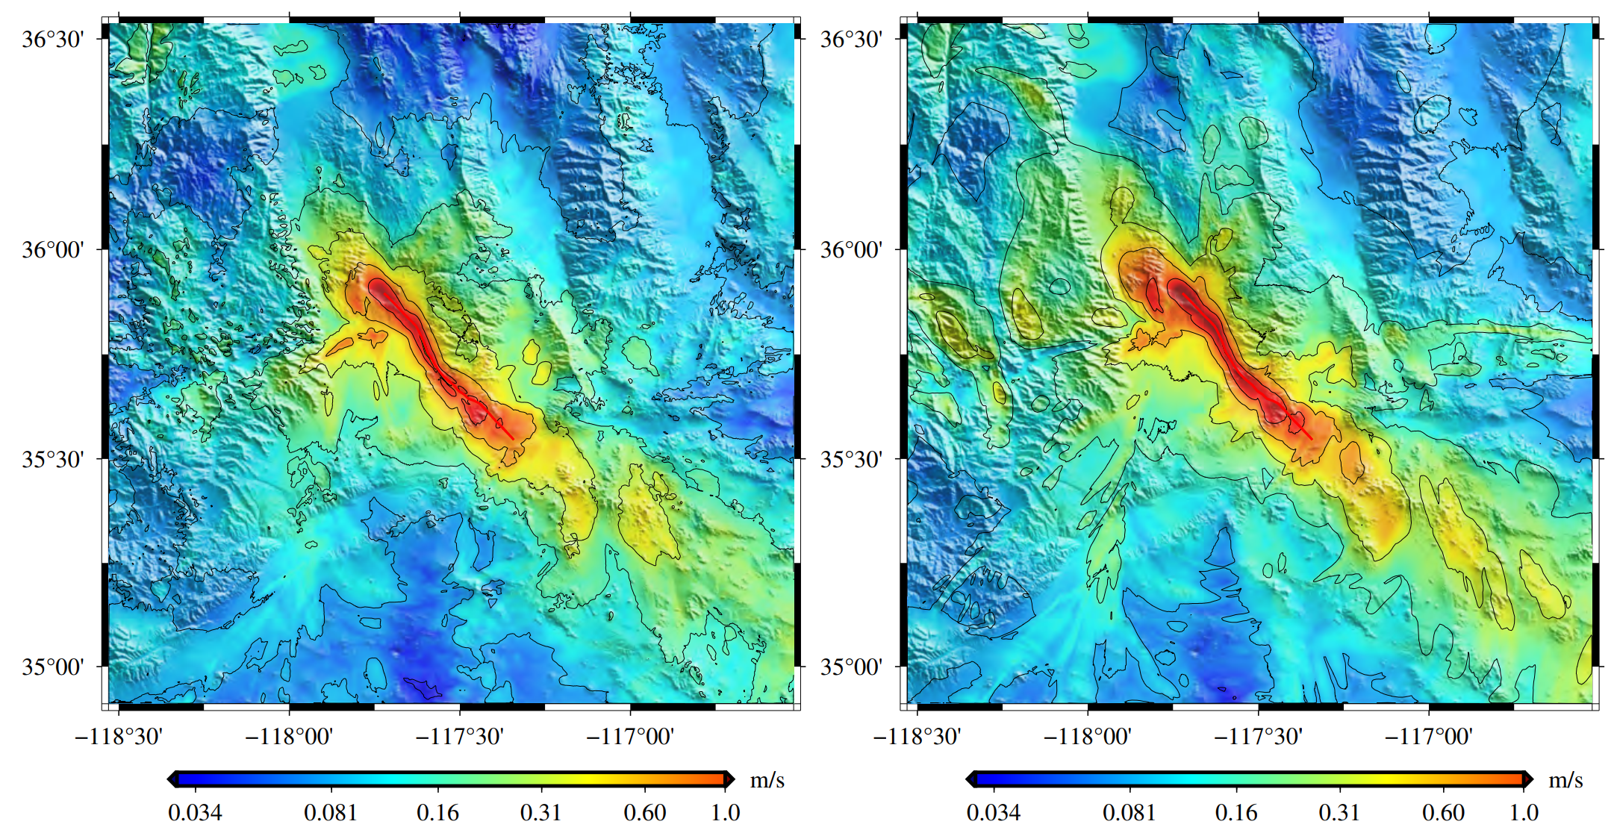
Ridgecrest Earthquake
With Terrain
Without Terrain
﻿The maximum frequencies of the two simulations reach 22.6 Hz.
A earthquake simulation with terrain can provide more detailed PGV (Peak Ground Velocity) distribution results.
﻿Comparison between 12m Ridgecrest earthquake simulations with (left) and without (right) terrain.
Notes:
This figure shows two simulation results of Ridgecrest Earthquake, one is with Terrain, anther without Terrain.
The maximum frequencies of the two simulations reach 22.6 Hz.
We easy to find that, earthquake simulation with terrain can provide more detailed PGV distribution results.
This means that we can obtain more precise hazard distributions.

Slide 42
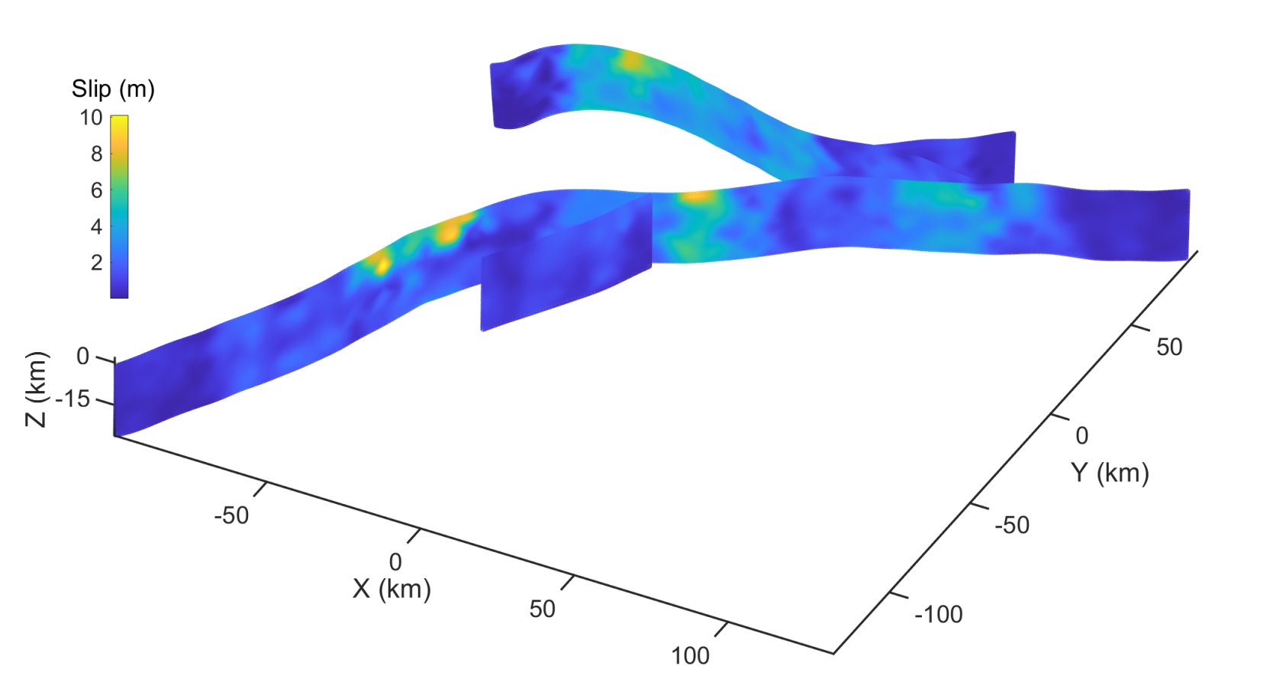
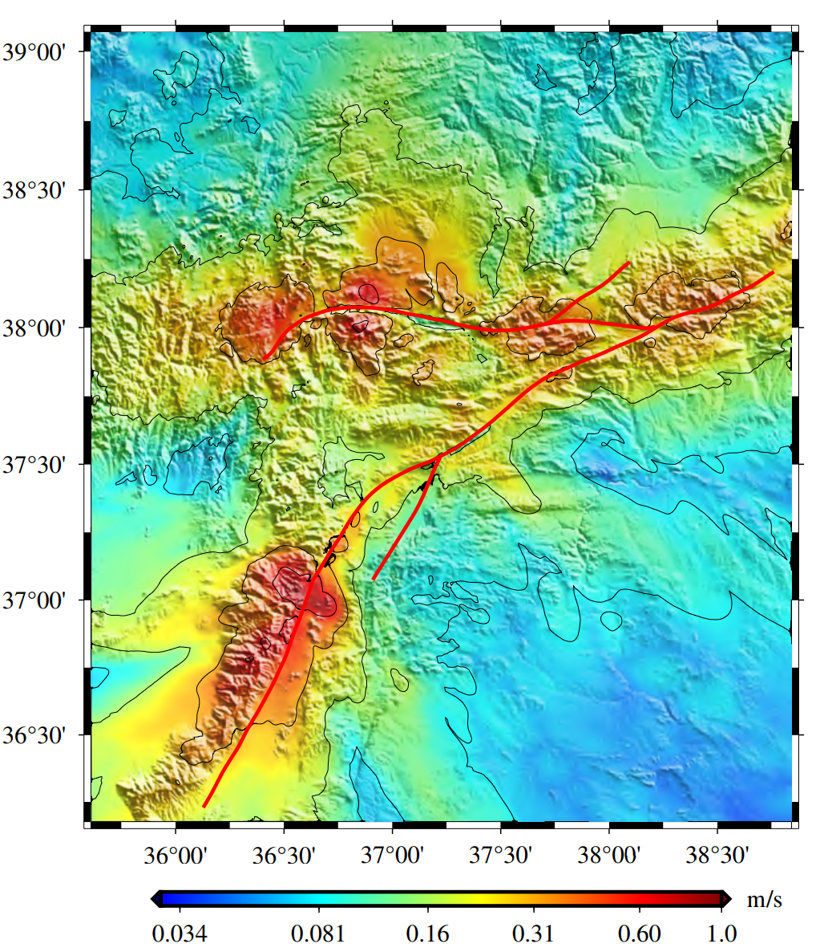
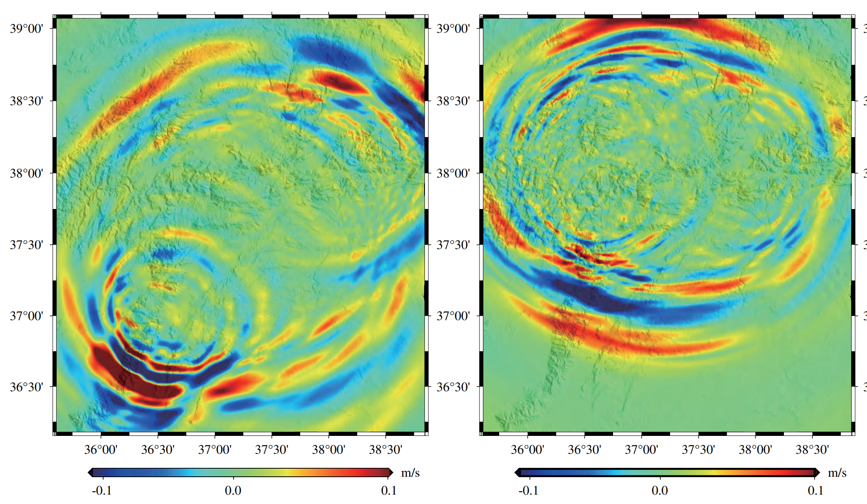
Turkey Earthquake
﻿Accurately simulated two earthquakes in Turkey in 2023.
Calculated the precise hazard distribution.
These results can guide urgent earthquake rescue and future hazard prevention.
﻿The crossing multi-faults of the 2023 Turkey earthquakes.
﻿The PGV distributions of the Turkey 𝑀𝑤 7.8 and 𝑀𝑤 7.6 earthquake.
(i) ﻿Wave snapshot of the Turkey 𝑀𝑤 7.8 earthquake.
(ii) ﻿Wave snapshot of the Turkey 𝑀𝑤 7.6 earthquake.
Notes:
We accurately simulated two earthquakes in Turkey using crossing multi-fault models with ﻿3D complex rupture geometries.
This brings significant challenges to our earthquake simulation.
Finally, We obtained the precise hazard distribution.
These results can guide urgent earthquake rescue and future hazard prevention.

Slide 43
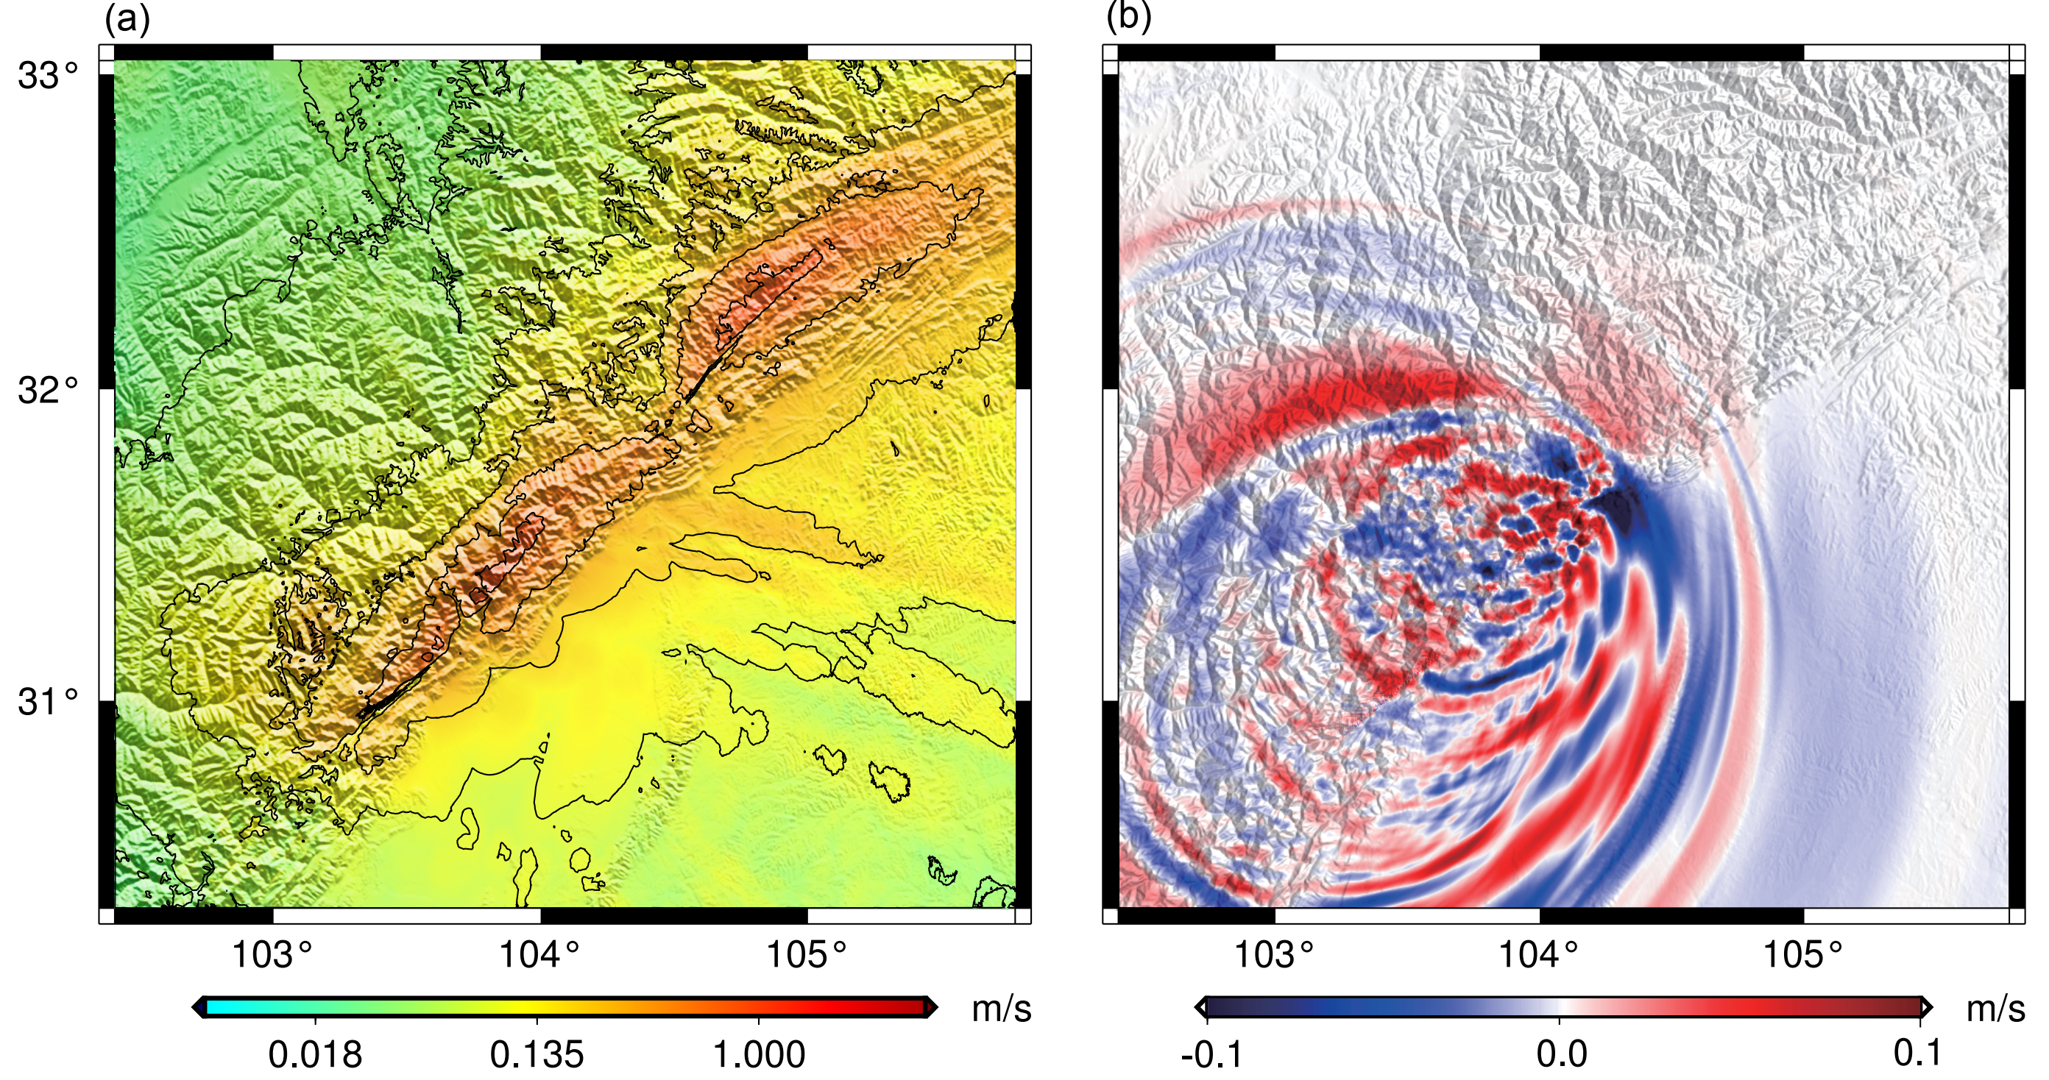
Wenchuan Earthquake
2008 Wenchuan Earthquake
315KM*300KM*60KM
10,500*10,000*2,000, 30 meter, 7.9Hz
Notes:
We accurately simulated two earthquakes in Turkey using crossing multi-fault models with ﻿3D complex rupture geometries.
This brings significant challenges to our earthquake simulation.
Finally, We obtained the precise hazard distribution.
These results can guide urgent earthquake rescue and future hazard prevention.

Slide 44
Outline
Background and Methods
Selected Supercomputer
Optimization Approaches
Performance and Earthquake Simulations
Conclusion

Slide 45
Conclusion
﻿This work adopts a novel earthquake algorithm allowing for more precise and realistic terrain descriptions in earthquake simulation.
This work proposes various optimization approaches, including process- and thread-level optimizations, a non-uniform decomposition method, and successfully scales the algorithm onto the New-Generation Sunway supercomputer.
﻿We achieved the peak sustained performance of 69.7 PFLOPS (parallel efficiency of 98.2%) and 65.2 PFLOPS (parallel efficiency of 98.1%) for compress and non-compress versions, respectively.
Notes:
Let me make a conclusion, our work …

Slide 46
Conclusion
﻿﻿Highly scalable algorithm enables us to perform earthquake simulations with crossing multi-faults and topography.
Several significant messages delivered by large-scale simulation results help domain experts to better understand earthquakes, and make evaluations of seismic hazards.
Deep leaning approaches are being explored.
Notes:
Let me make a conclusion, our work …

Slide 47
Thank You
lingan@tsinghua.edu.cn

